Slide 1
SSWIM volunteer visit to Malawi,
Oct - Nov 2015
Nigel Hall
Former Senior Lecturer,
Kingston University and,
School of Social Work, Zimbabwe,
IFSW Rep.
Norma Hall
MSW, former PMHW/CAMHS, Systemic Family Therapist UK/Zimbabwe, ZCWC/ZACRO women’s projects, Zimbabwe.

Slide 2
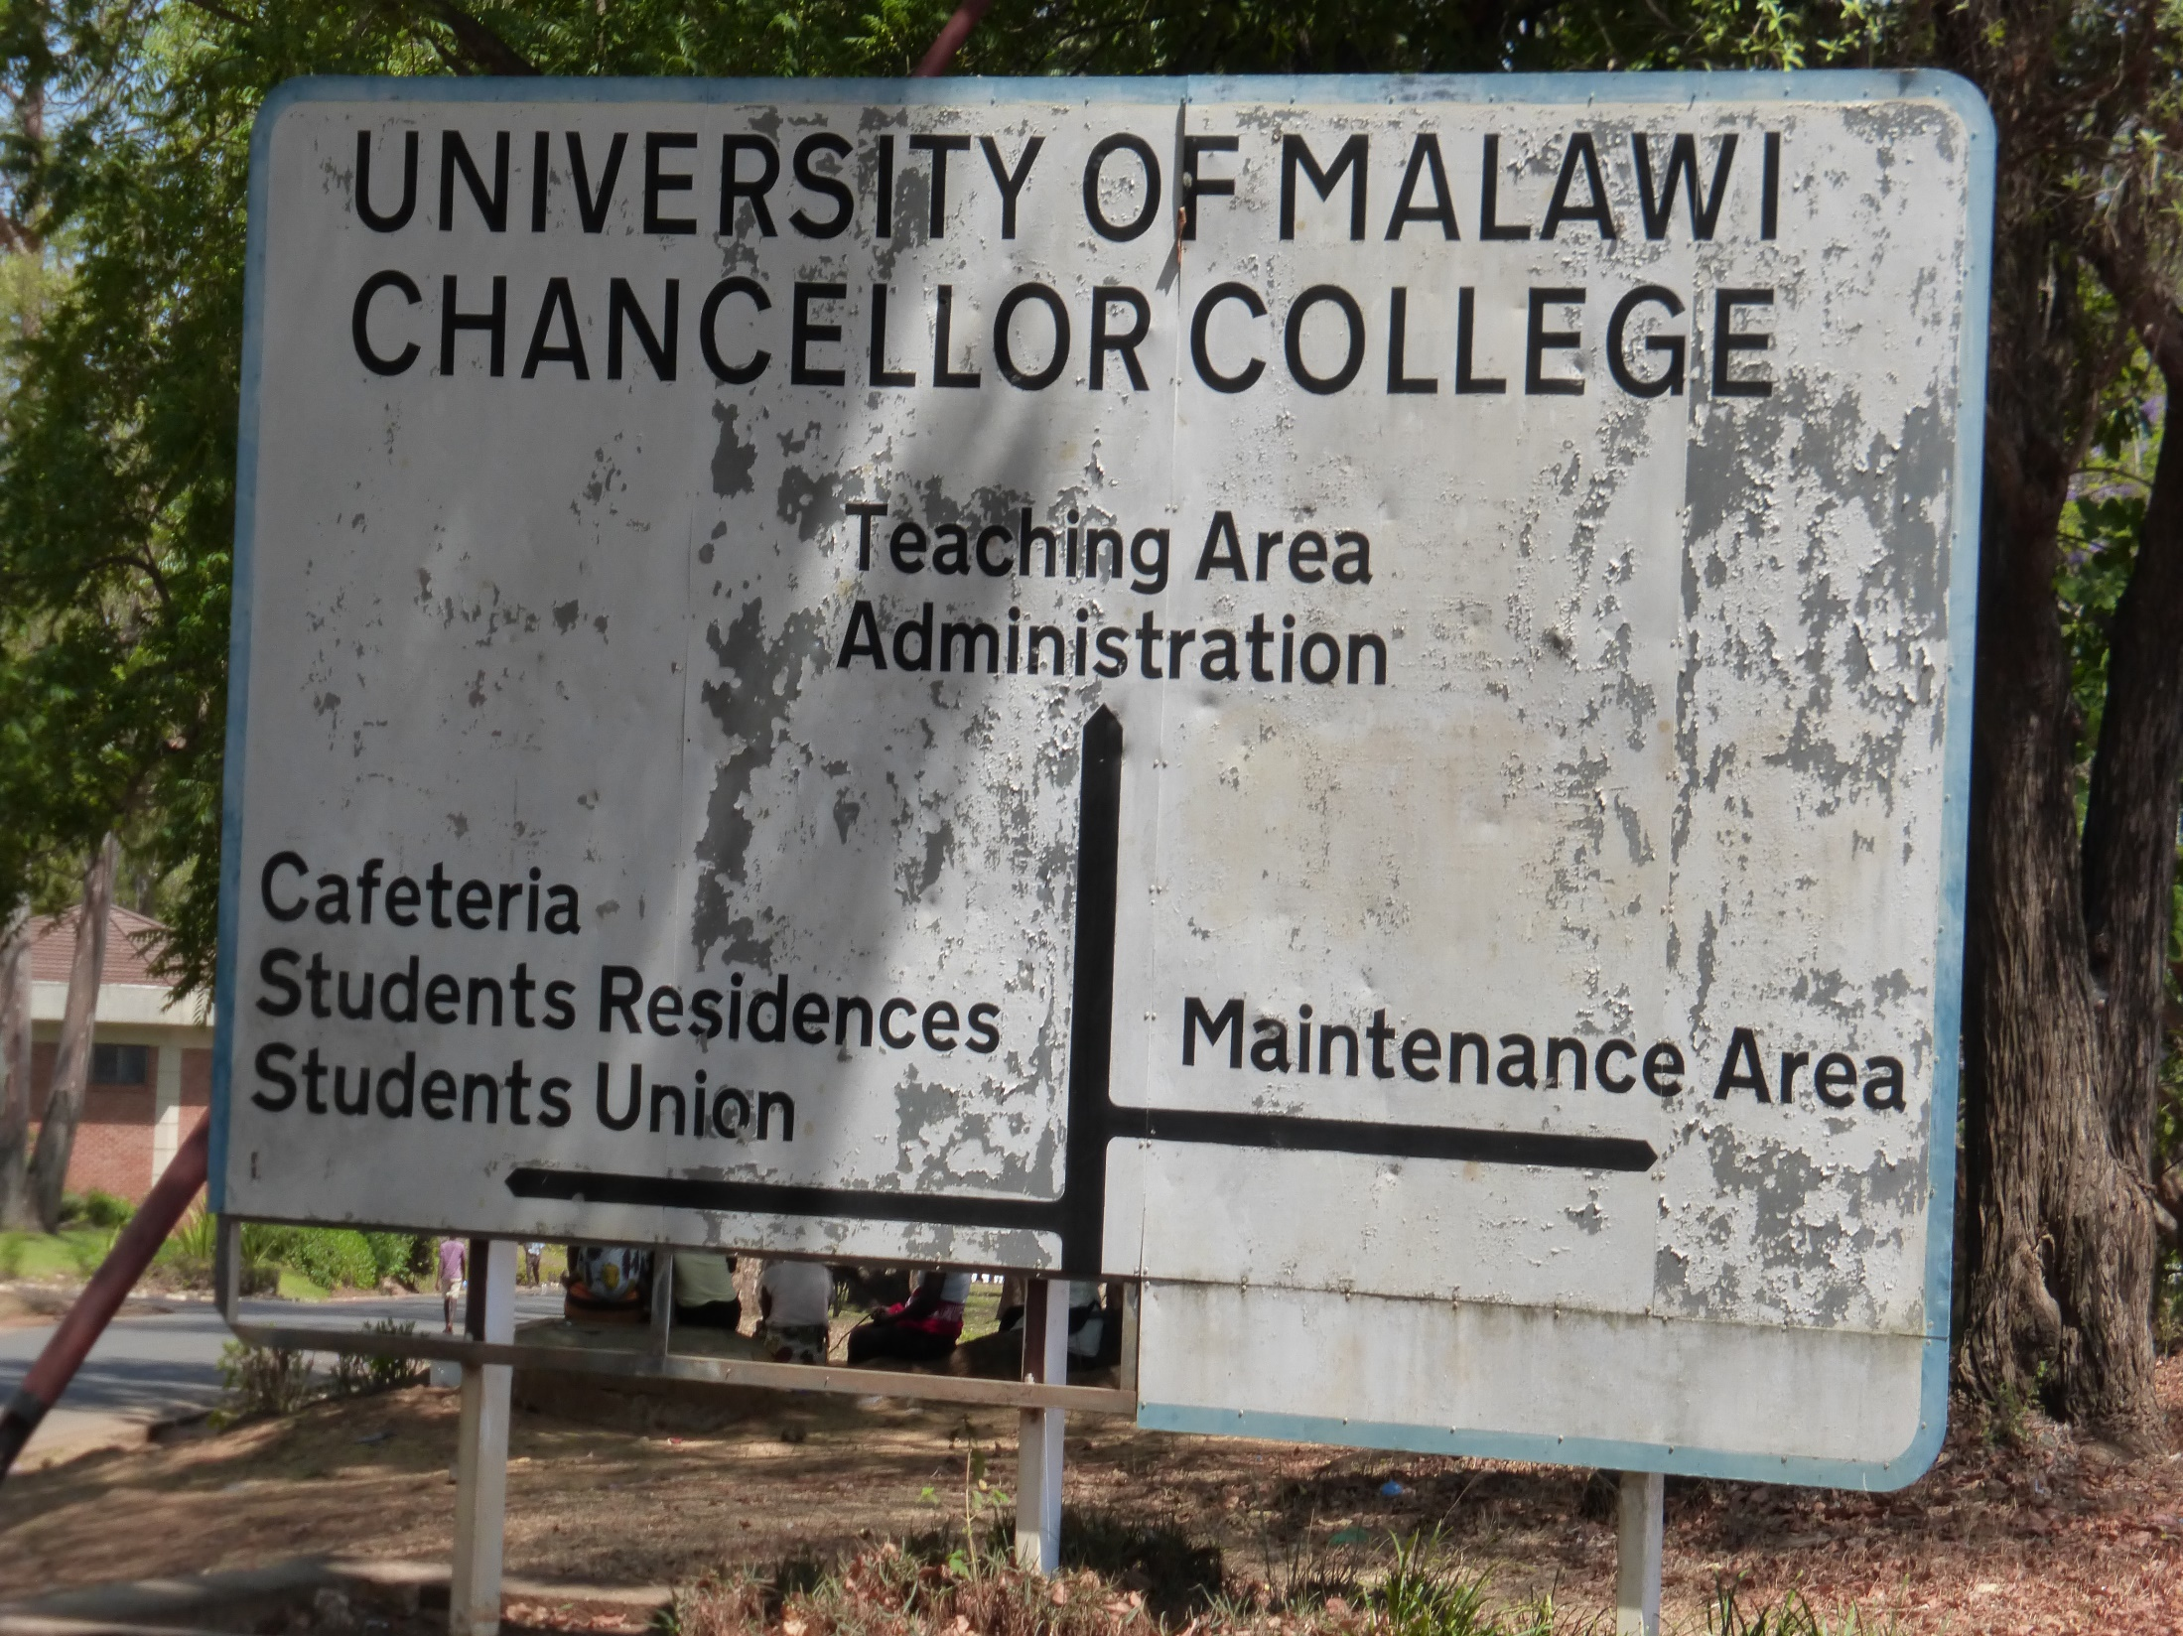

Slide 3
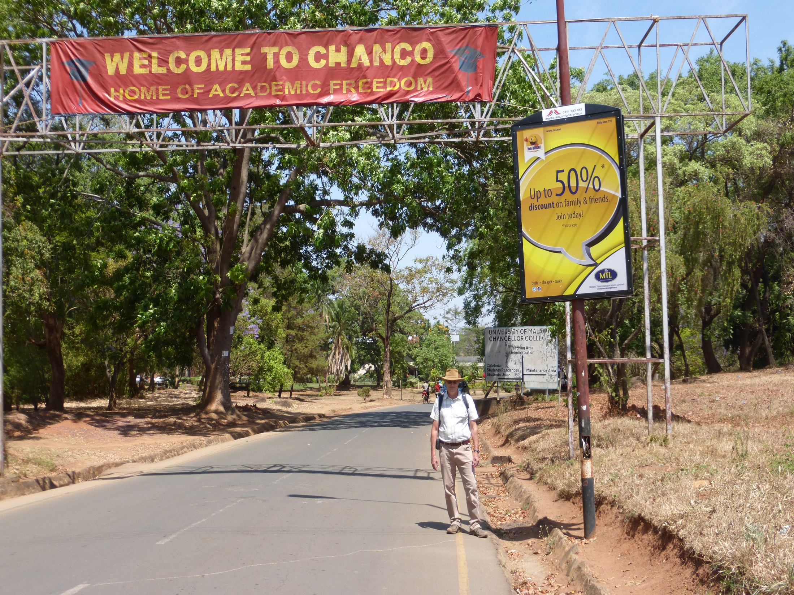

Slide 4
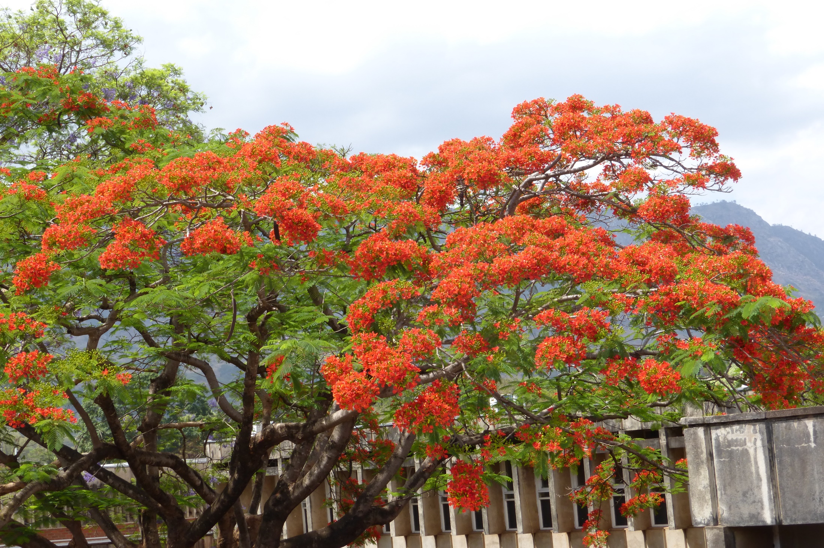
Chanco in bloom

Slide 5
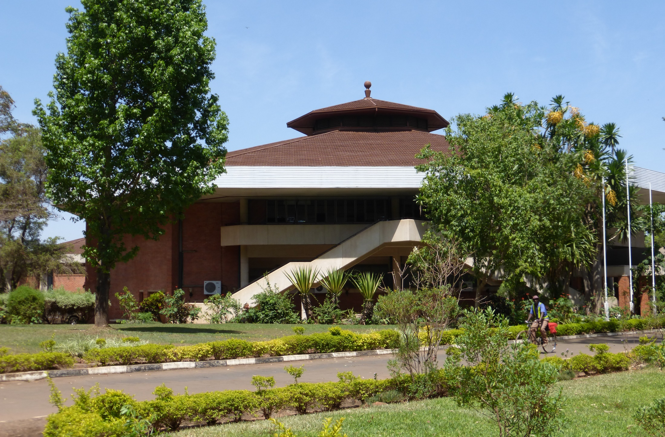
Chancellors College, Zomba

Slide 6
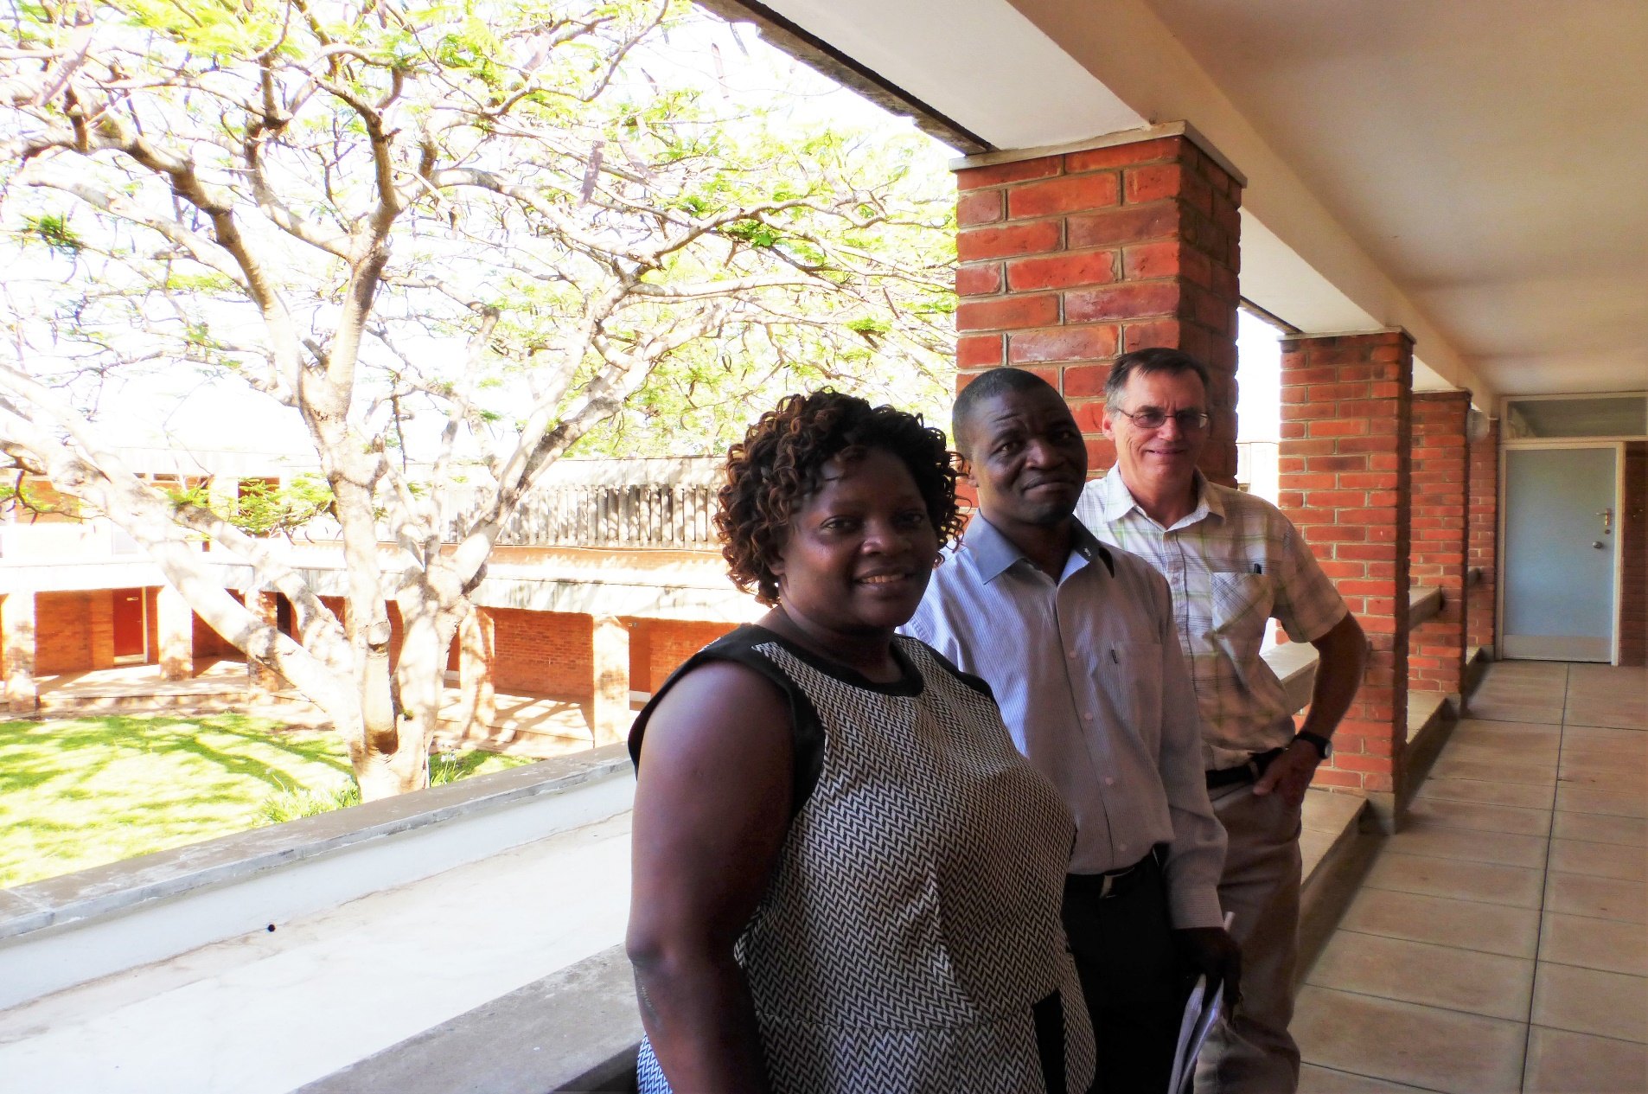
Social Work Head of Department Freda Katsandire,
Deputy Dean Phillip Kapulula, Nigel Hall at Chanco

Slide 7
Purpose of this visit
Brief is to focus on assisting with the development of placements on the degree course
Help identify suitable placements
Assist staff draw up necessary placement documentation, including placement agreement, assessment tools and report templates
Explore viability of different placement models, supervision and required training
Further the development of the National Association of Social Workers
Future co-operation with SSWIM through volunteer and/or exchange visits

Slide 8
Involved in student supervision…
Practice
Educator
Agency Supervisor
Student
University Tutor

Slide 9
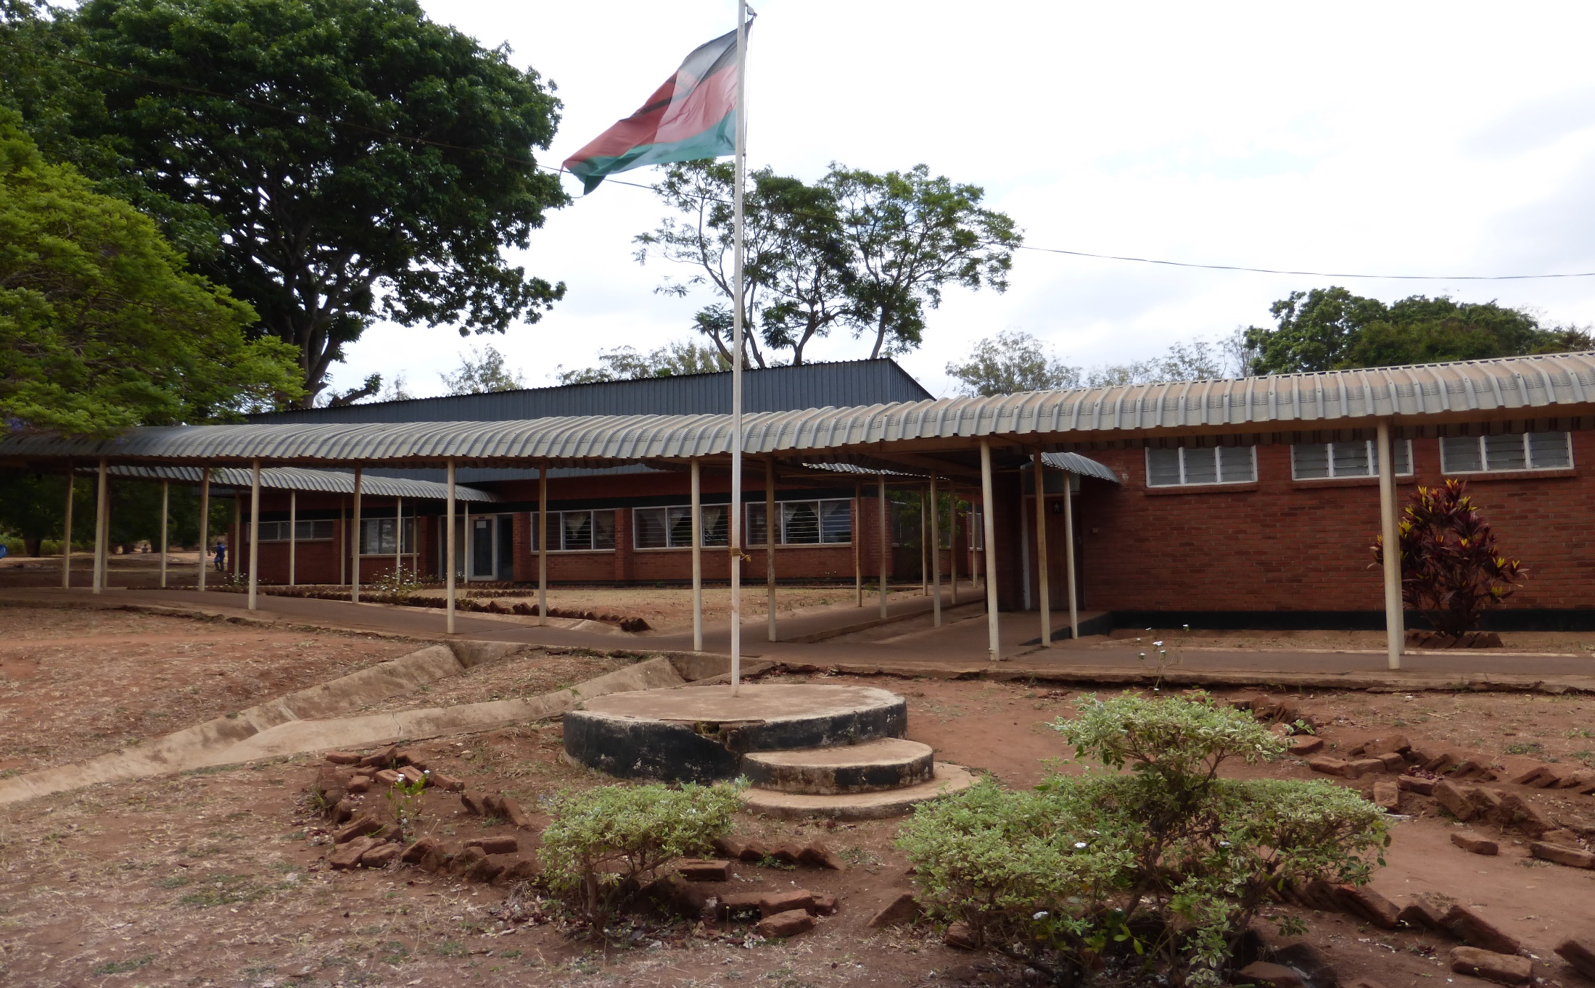
Magomero College, near Zomba

Slide 10
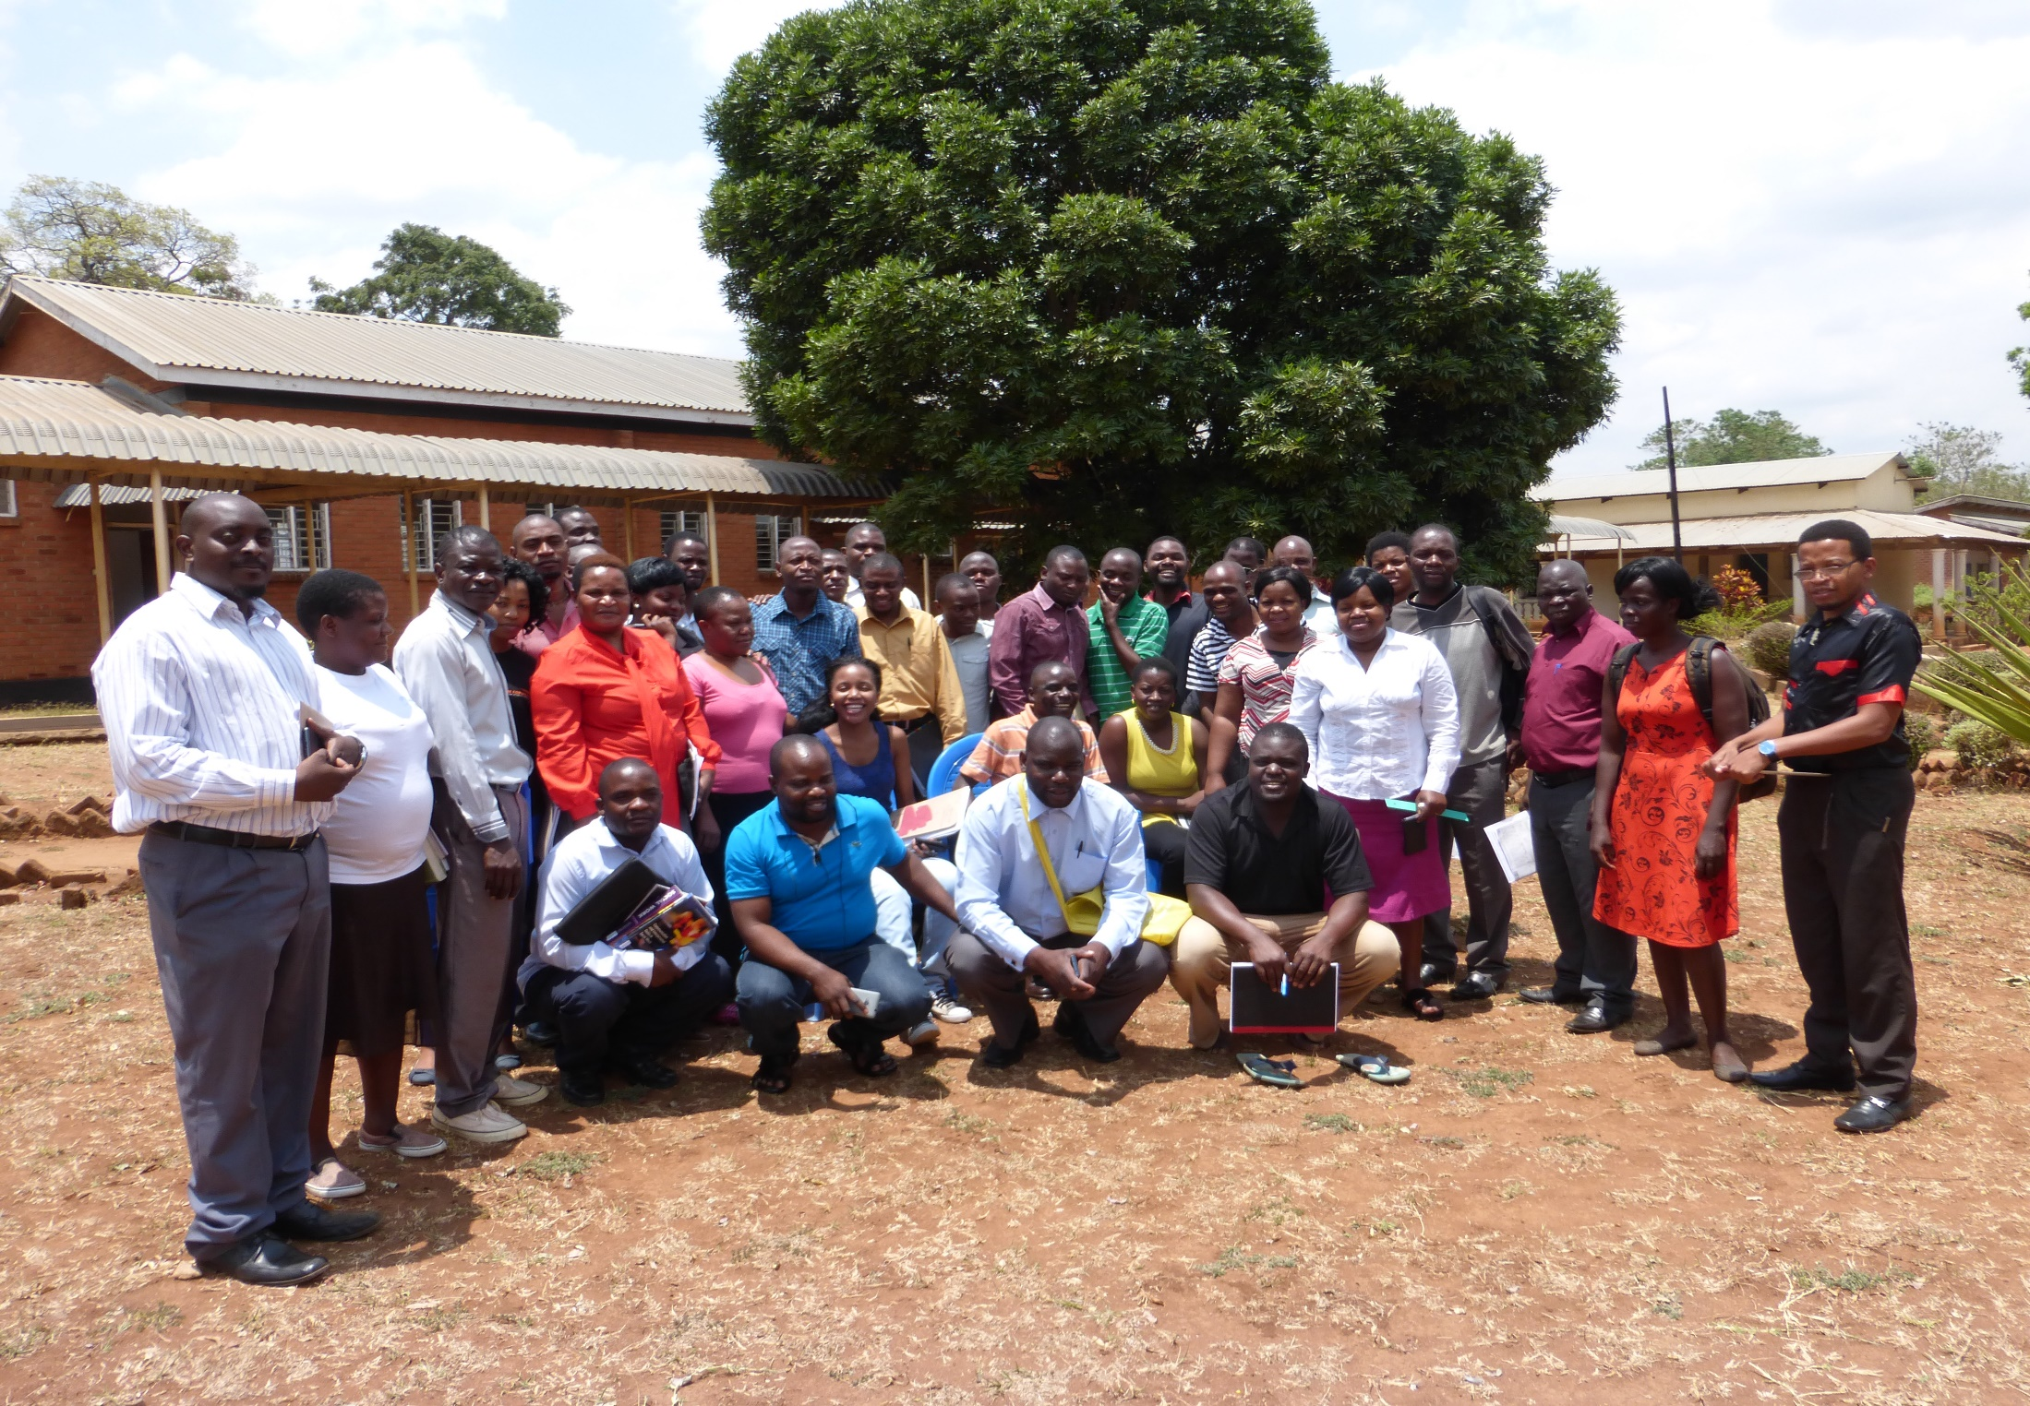
Felix Kakowa (left) with current BSW cohort at Magomero

Slide 11
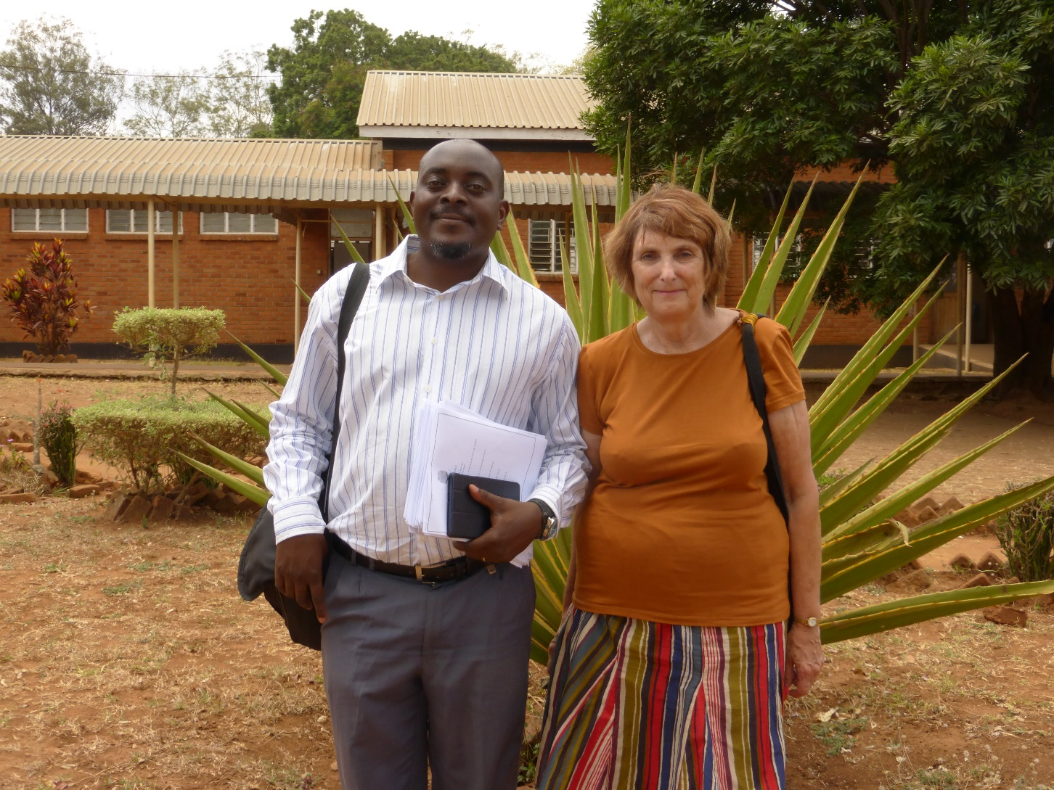
Felix and Norma at Magomero

Slide 12
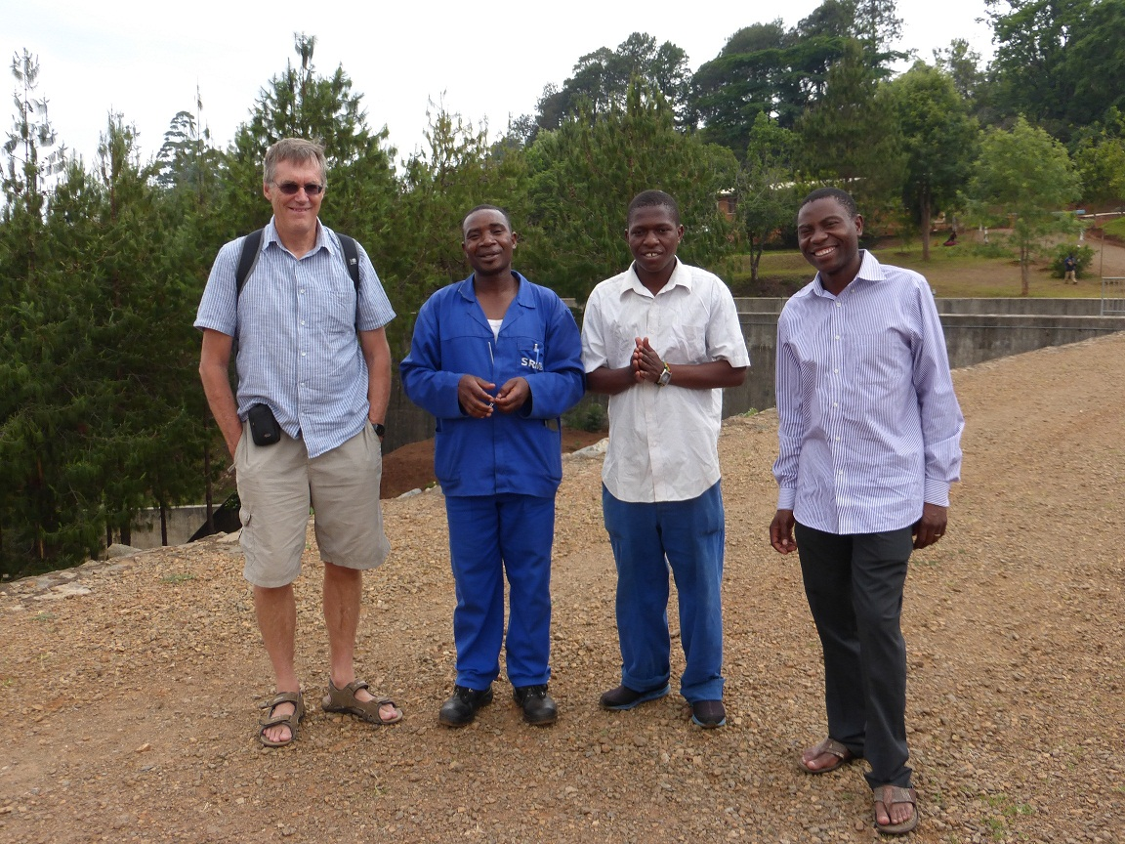
Nigel with Noel Muridzo (on right), IFSW Board member and others

Slide 13
Outcomes
Presentation/group exercise with staff on purpose of placements and possible models of placement supervision
Draft placement list produced
Decision on form of placement supervision and training needs (practice educators)
Presentation to students and group work exercise (Global Agenda and Definition of Social Work)

Slide 14
Outcomes cont…
Comprehensive Placement document folder produced after discussion and agreement
Future needs and cooperation identified including possible volunteer and staff exchange visit
Substantial progress with development of National Association, task force and links for ongoing support with IFSW Africa rep in Zimbabwe, UNICEF, etc.

Slide 15

Passion centre (Orphanage)

Slide 16
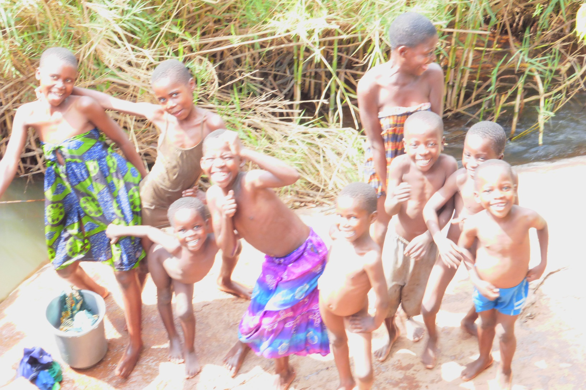
The Children

Slide 17
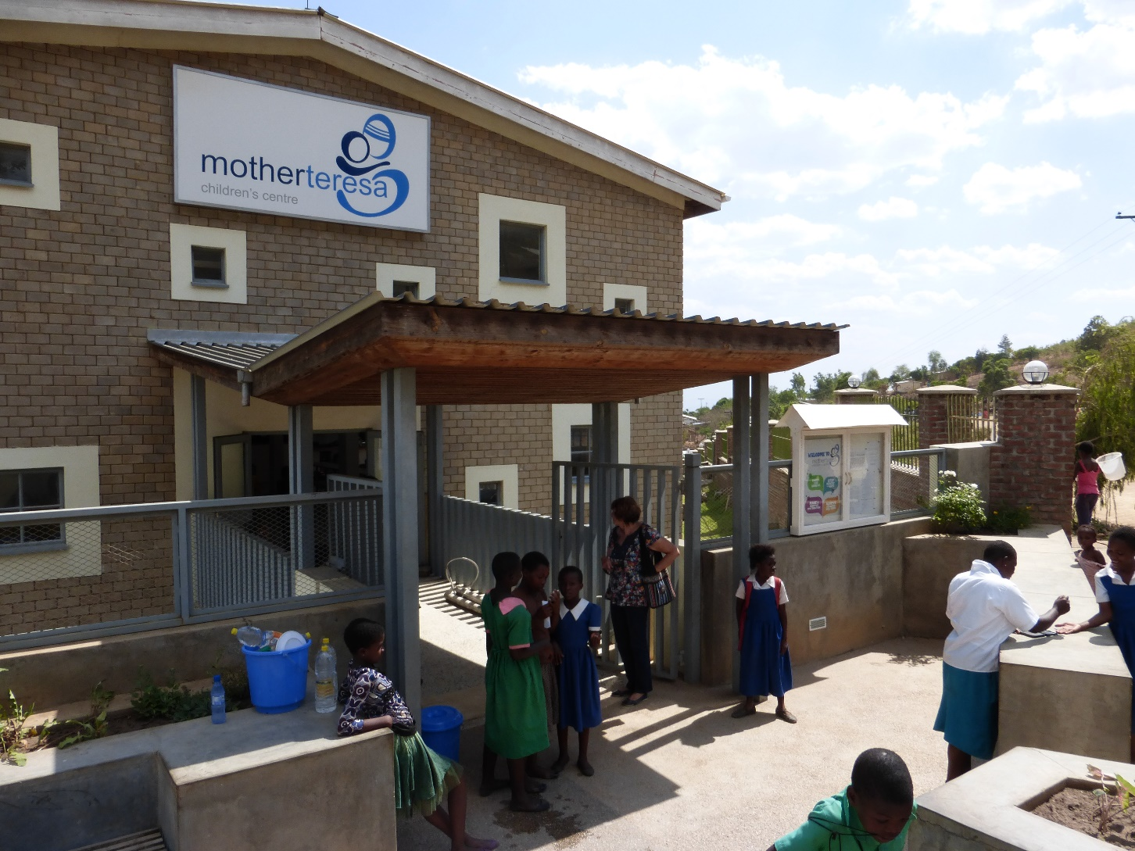
Mother Teresa’s Children’s Centre, Blantyre

Slide 18
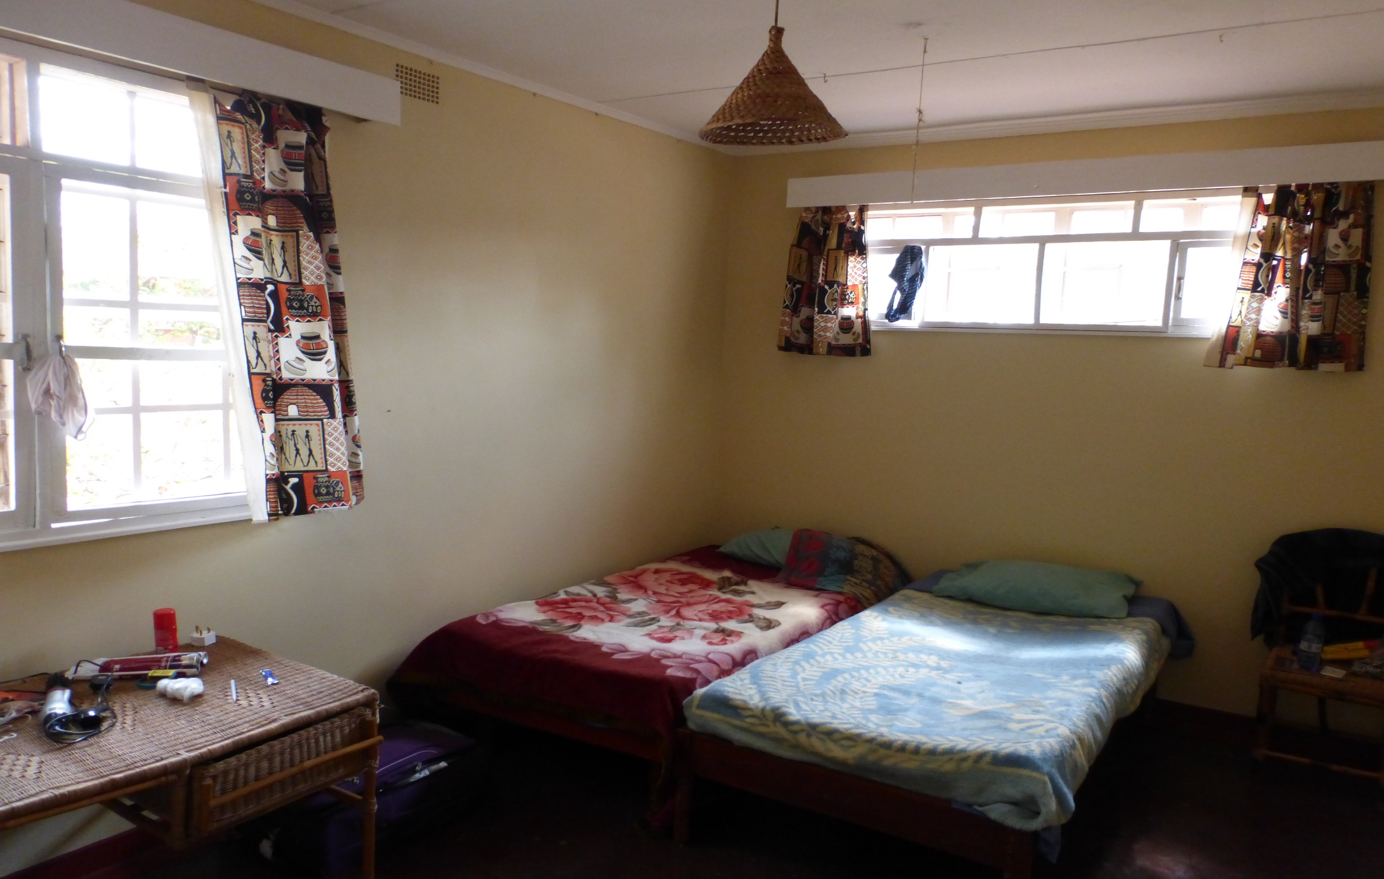
Our accommodation

Slide 19
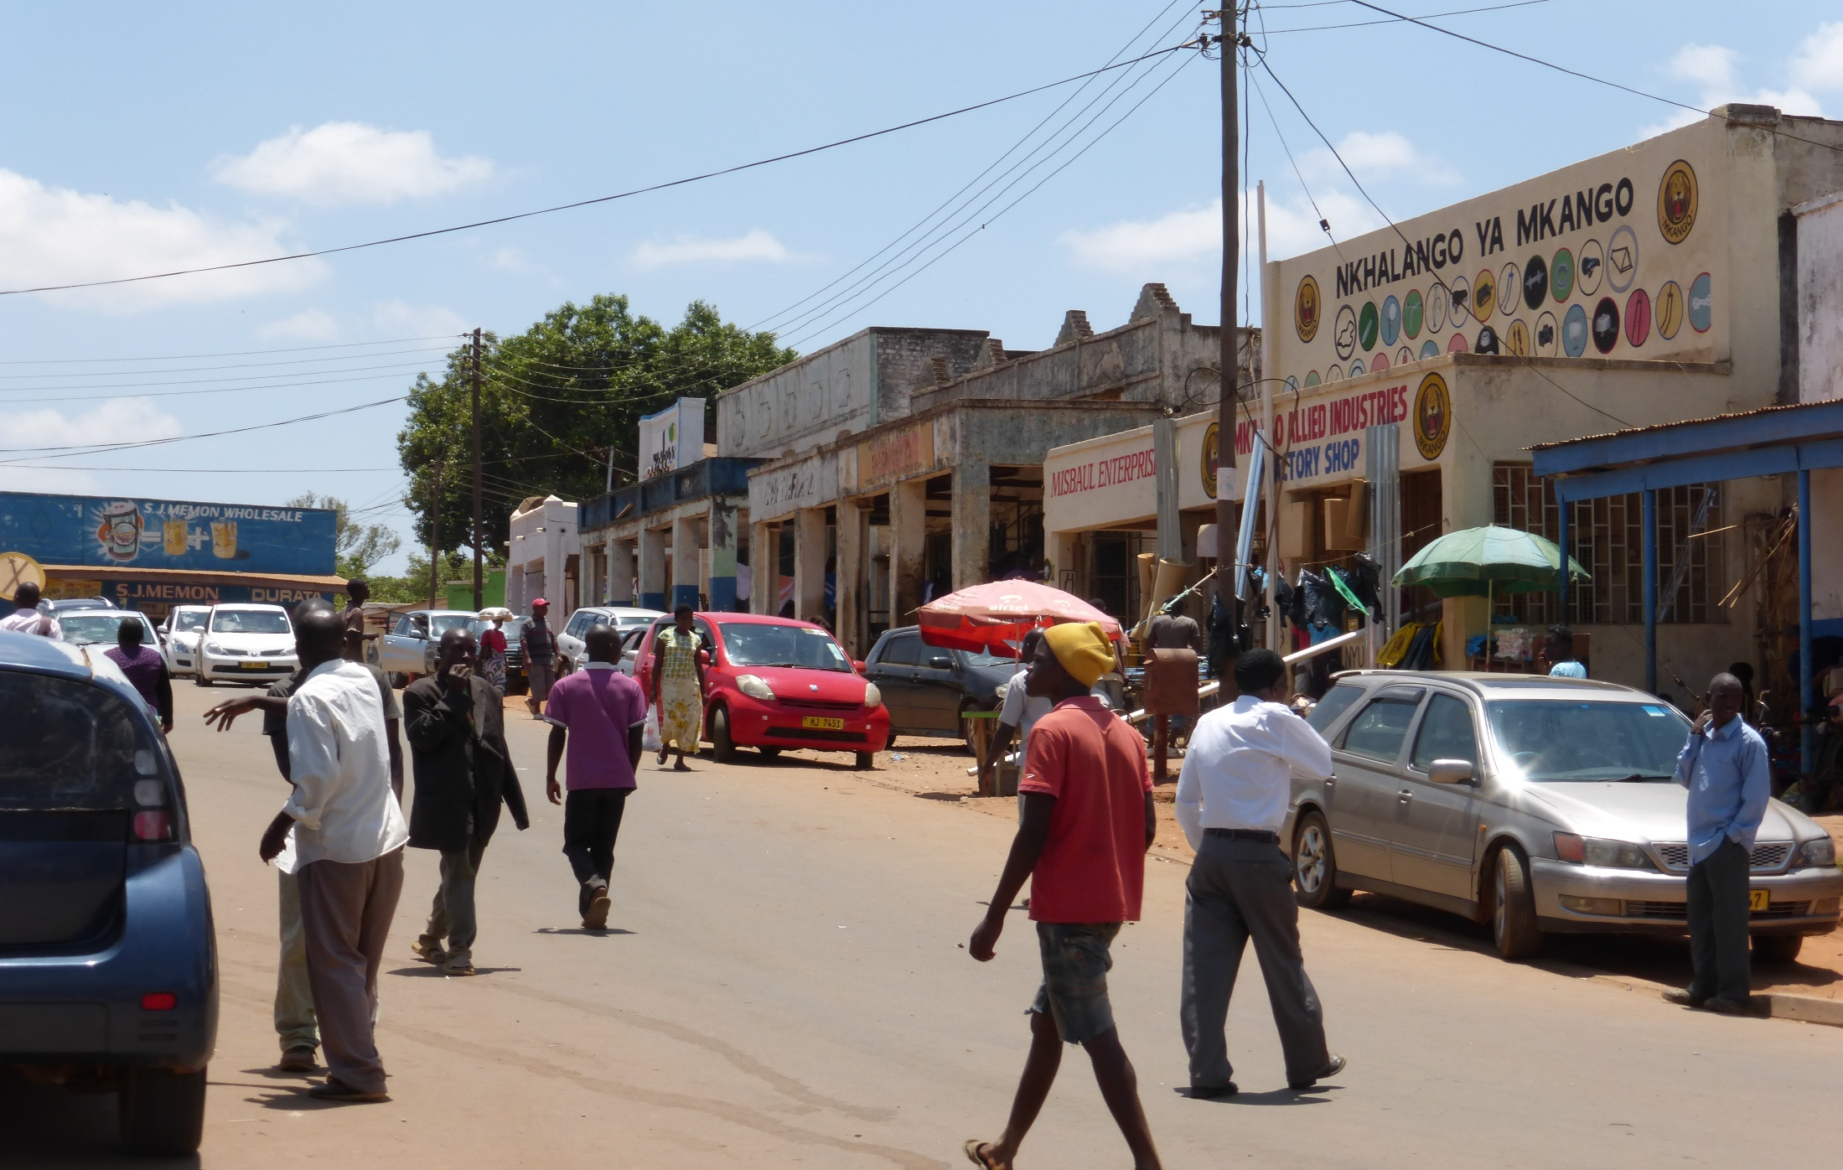
Zomba town

Slide 20
Future actions
Fund raising to support further SSWIM activities
Finalising plans for the Practice Educator training
Exploring further social work teaching input and
volunteer role in rolling out practice placements/
assisting practice educators and agency staff.
Possible staff/student links with other Universities
Further exploration of the practice training offered by the Catholic and DMI Universities in Malawi and establishing greater consistency

