Slide 1
Supporting Social Work in Malawi: what Simon and Andrew did in April 2015…
Andrew Hill & Simon Cauvain

Slide 2
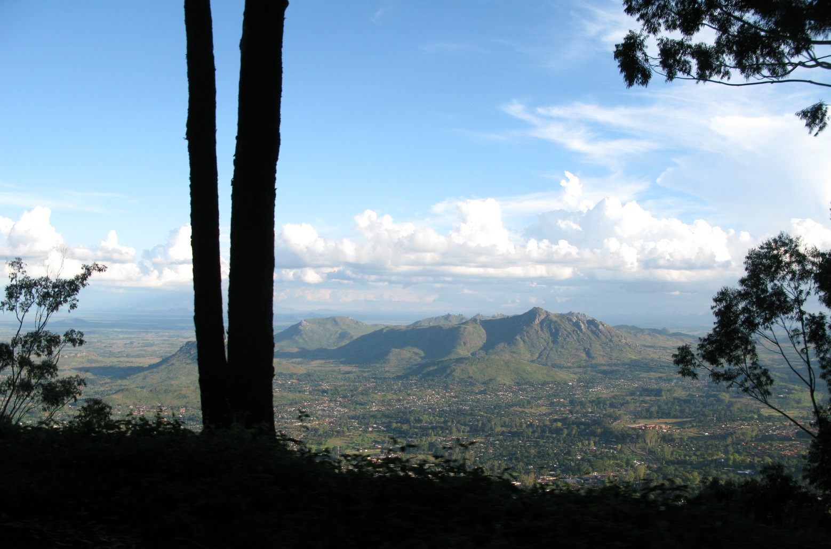
Sunday
Sightseeing on Zomba plateau – magnificent!

Slide 3
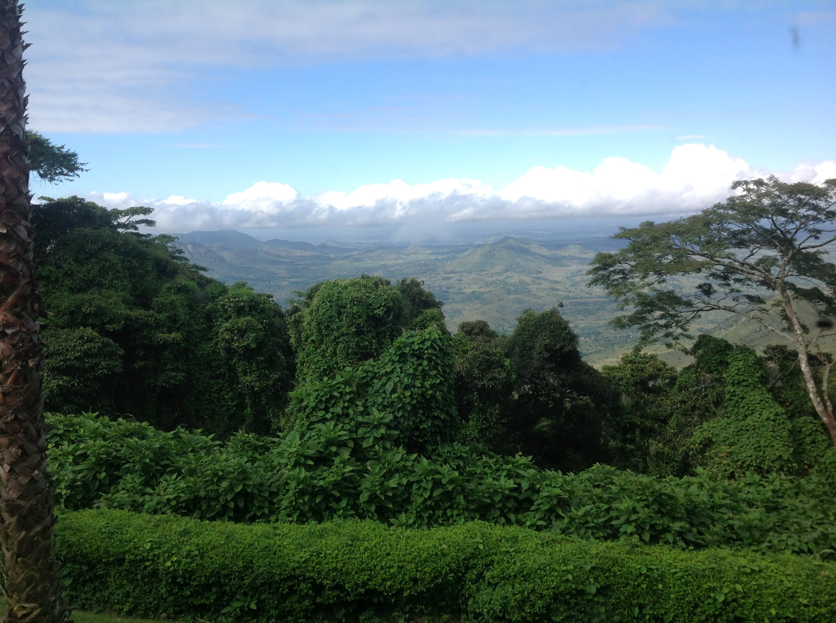

Slide 4
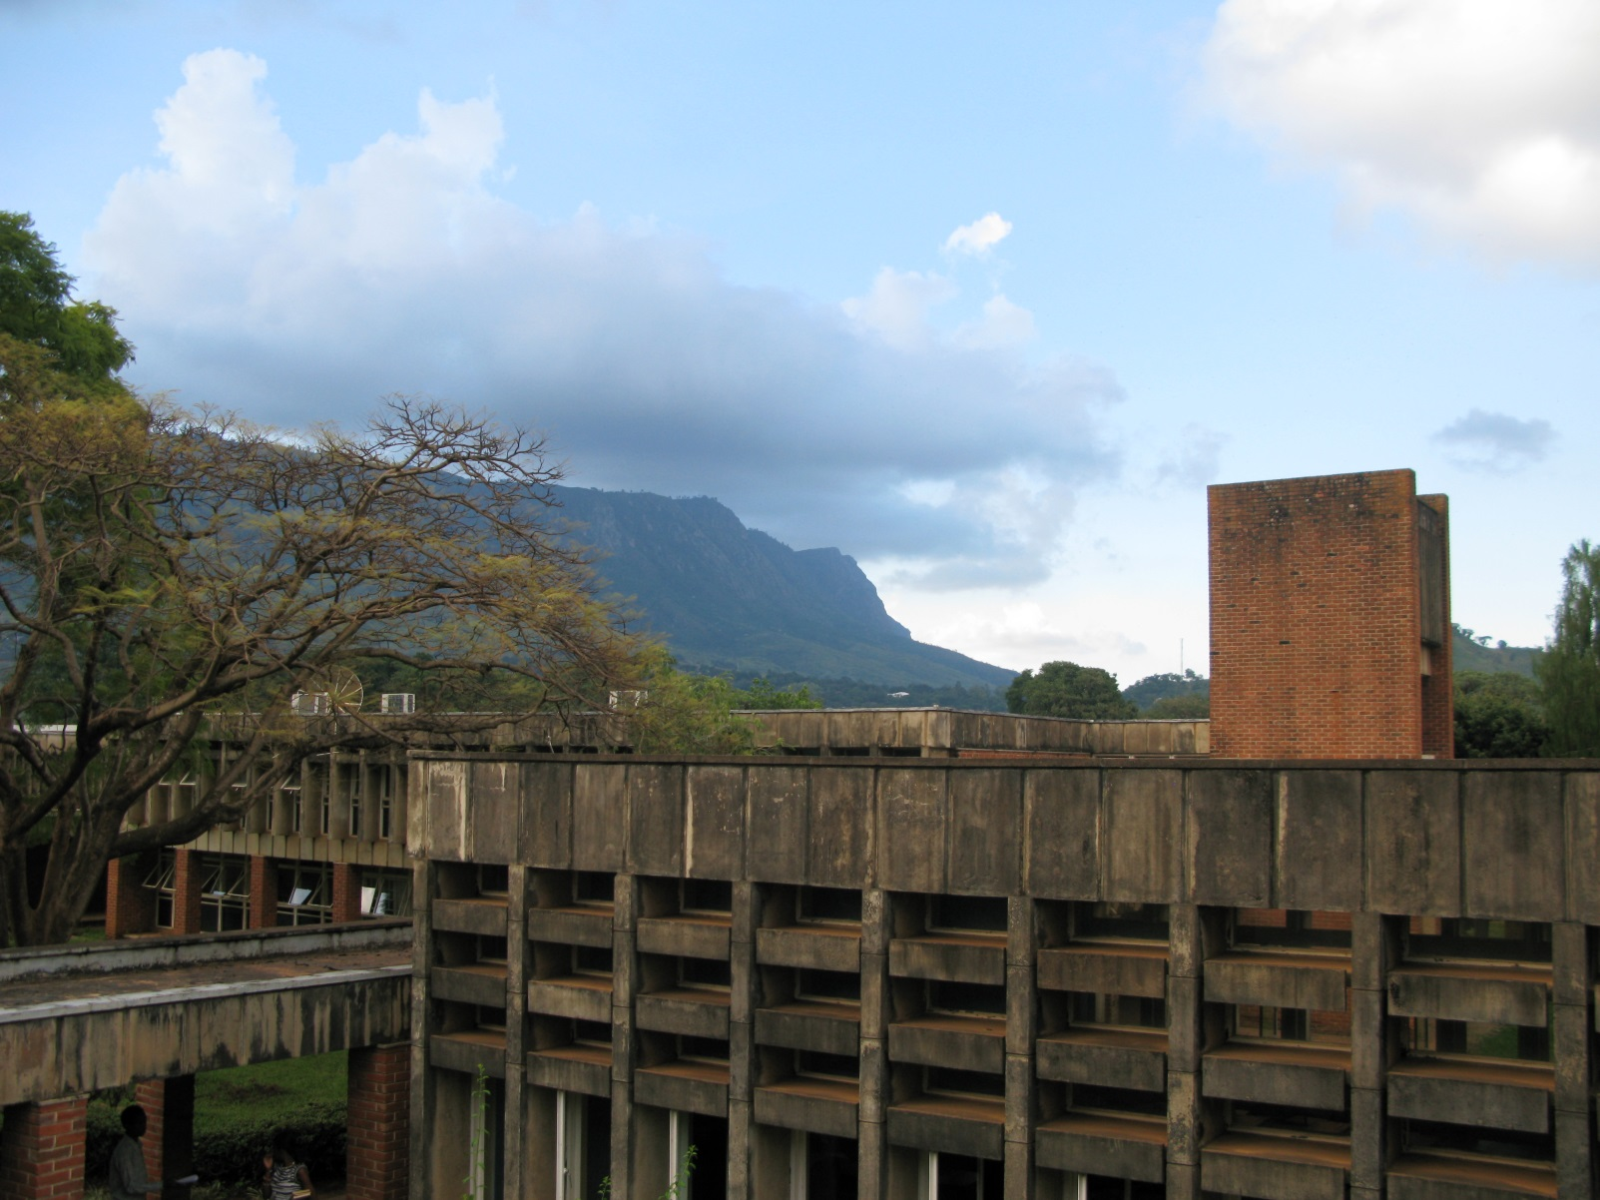
The plateau from the university campus

Slide 5
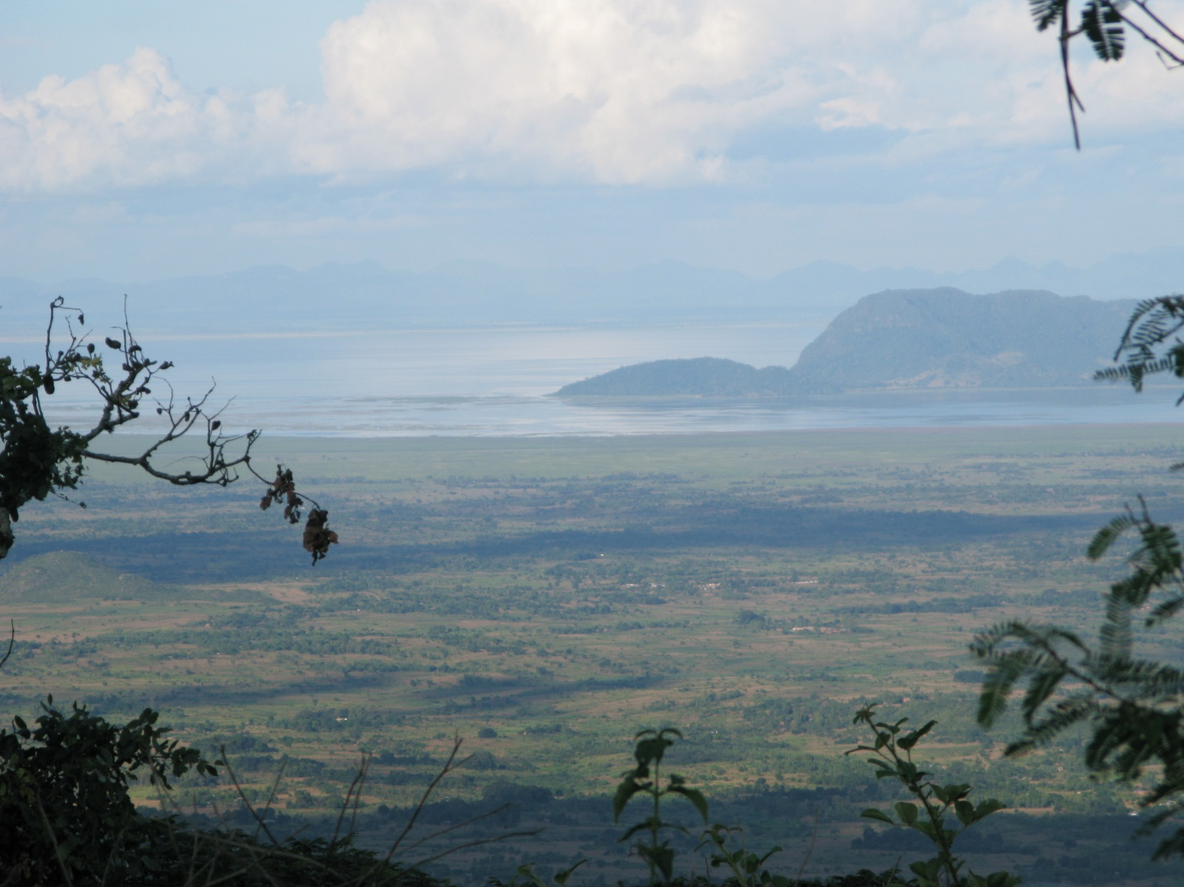
Lake Chilwa

Slide 6
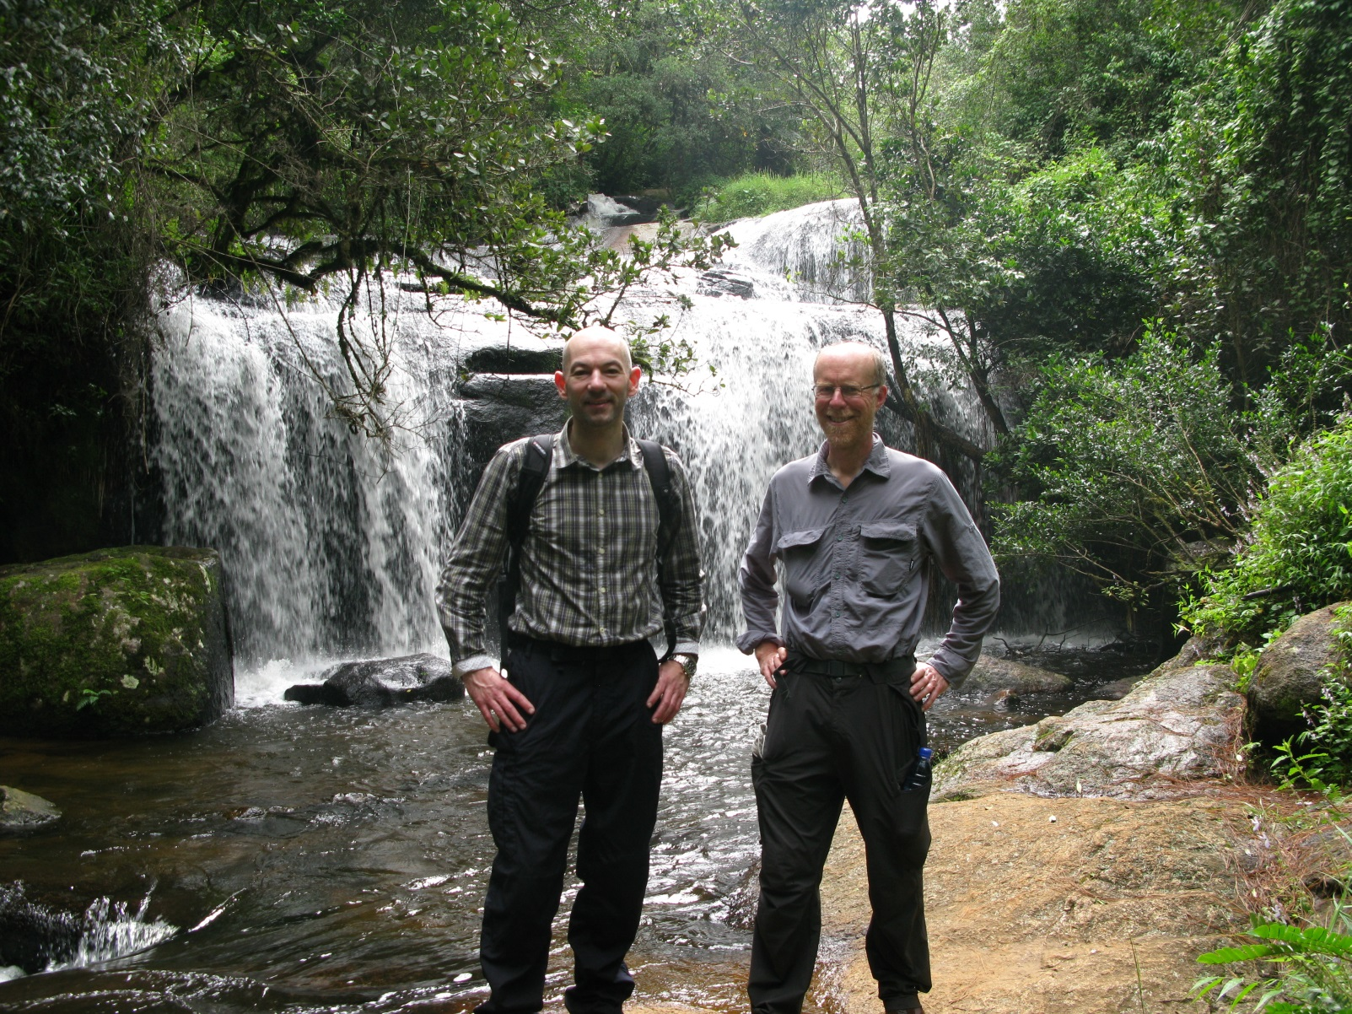
Williams Falls

Slide 7
Monday morning
Formal introductions
Phillip – Head of Sociology
Levison - Dean of Social Science
Richard - Principal of Chanco

Slide 8
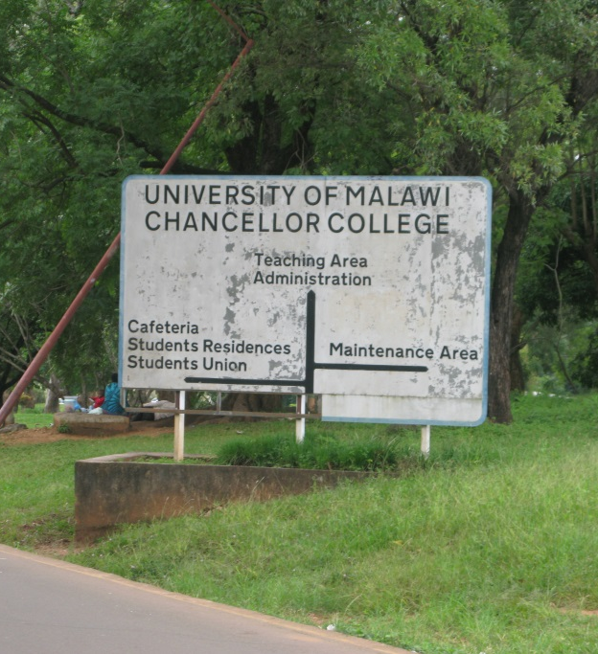
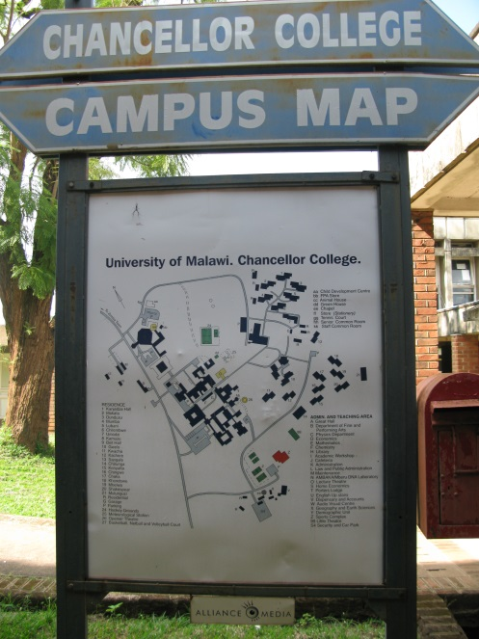
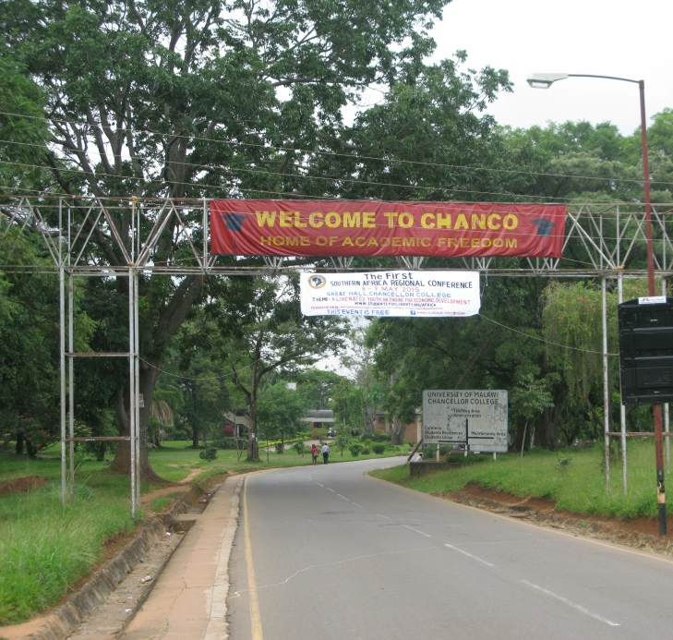
Chanco

Slide 9
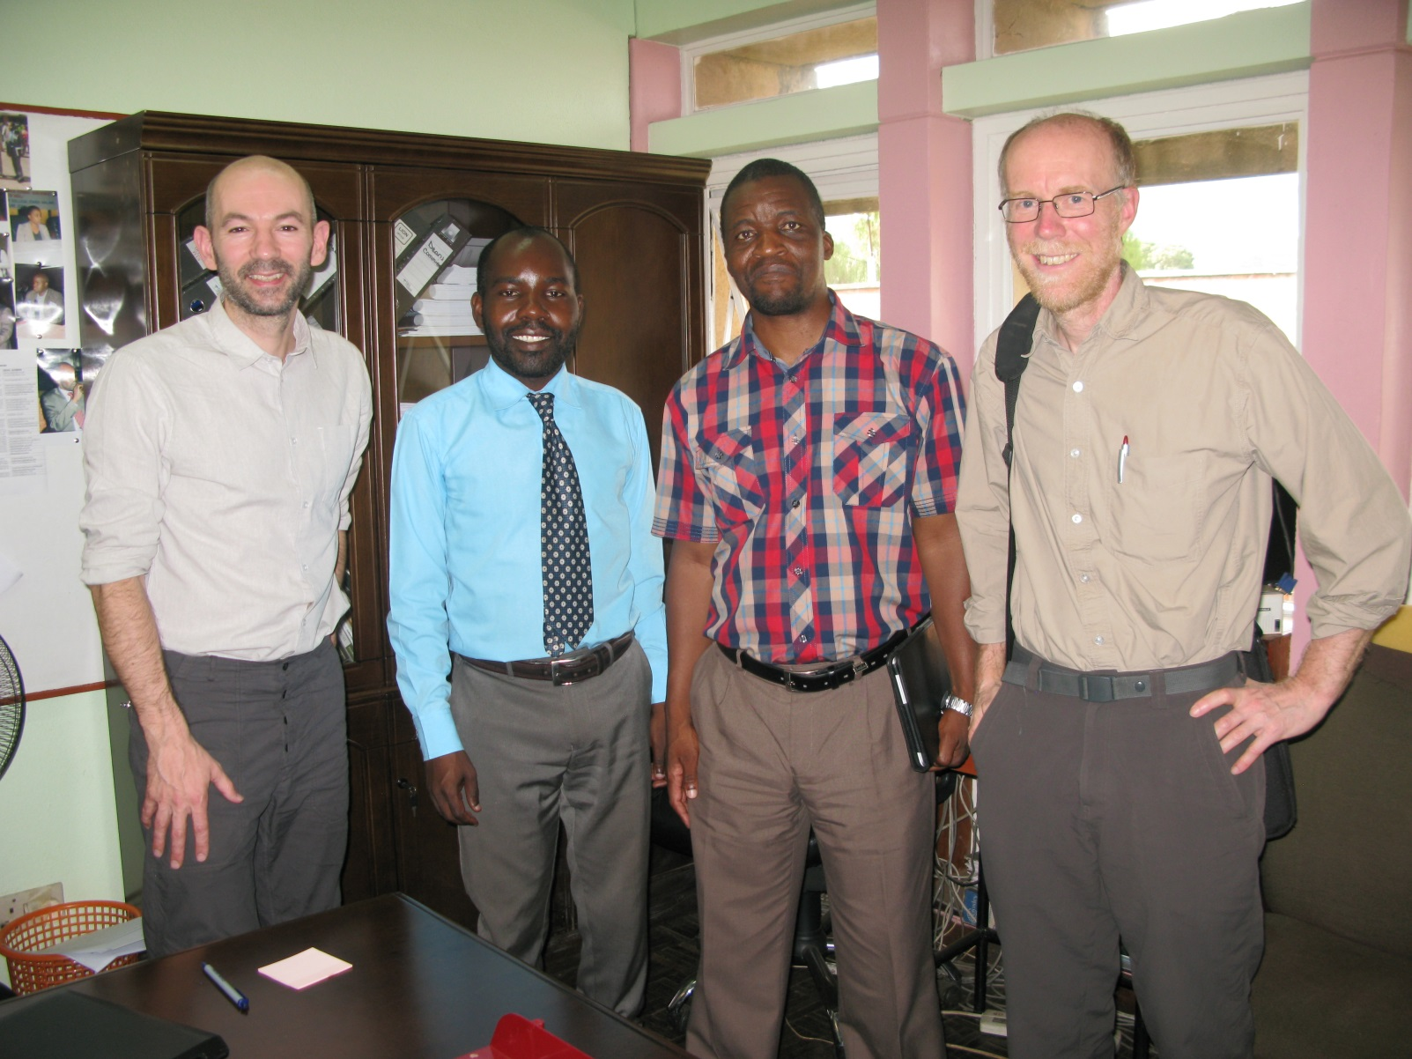
Levison and Phillip

Slide 10
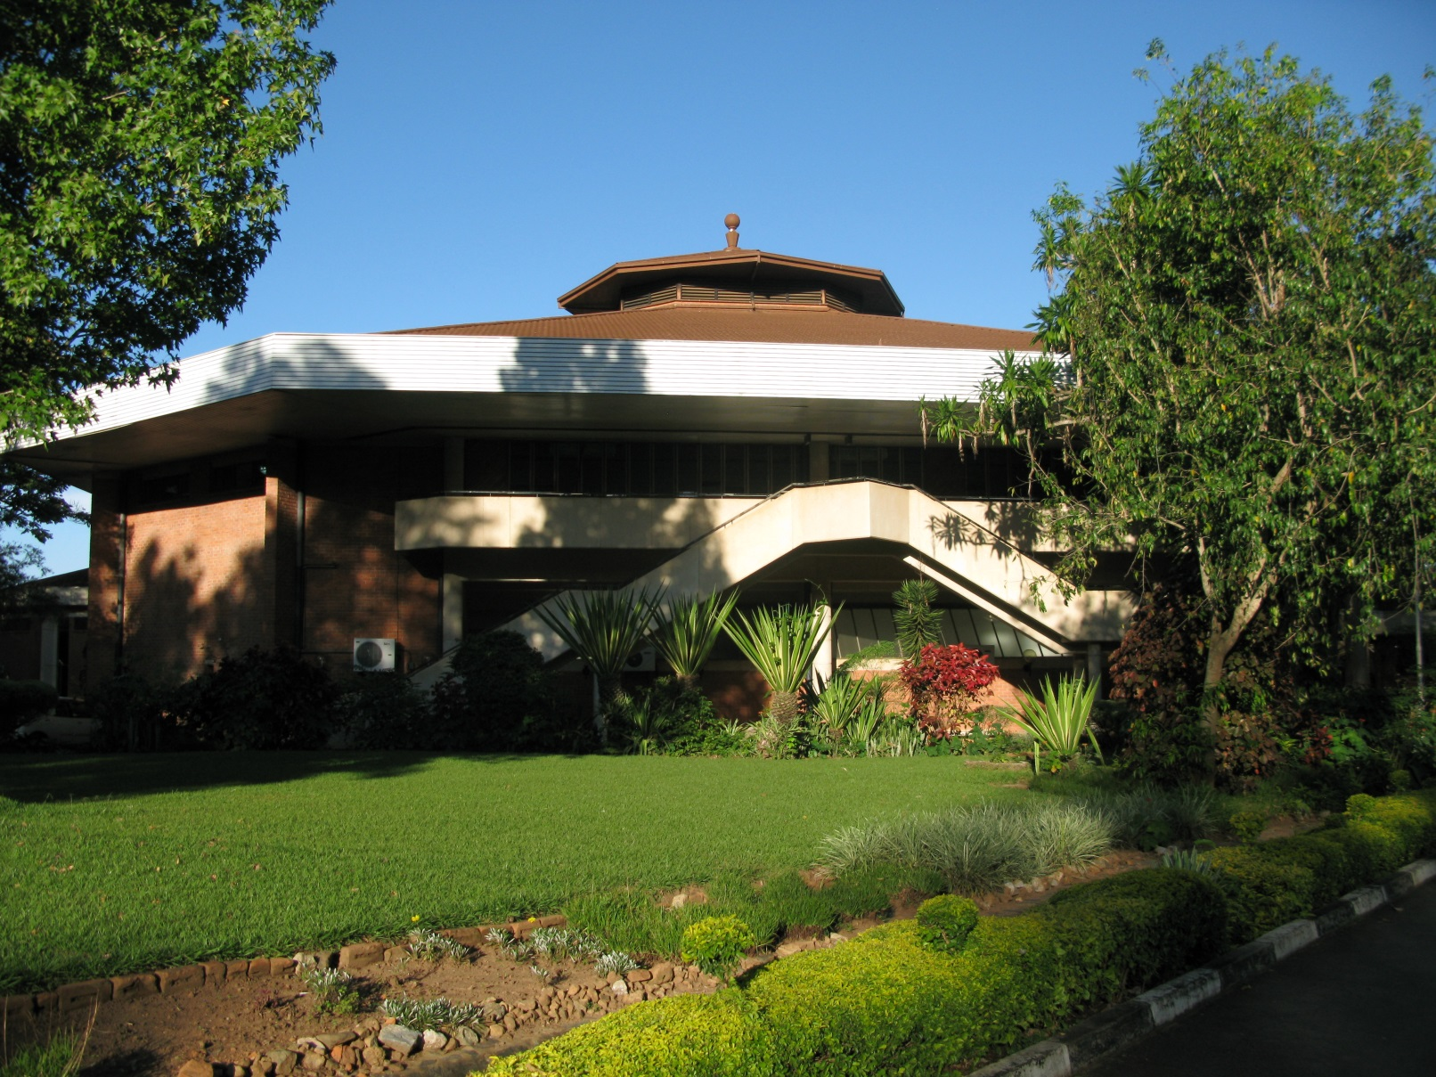
Look familiar?

Slide 11
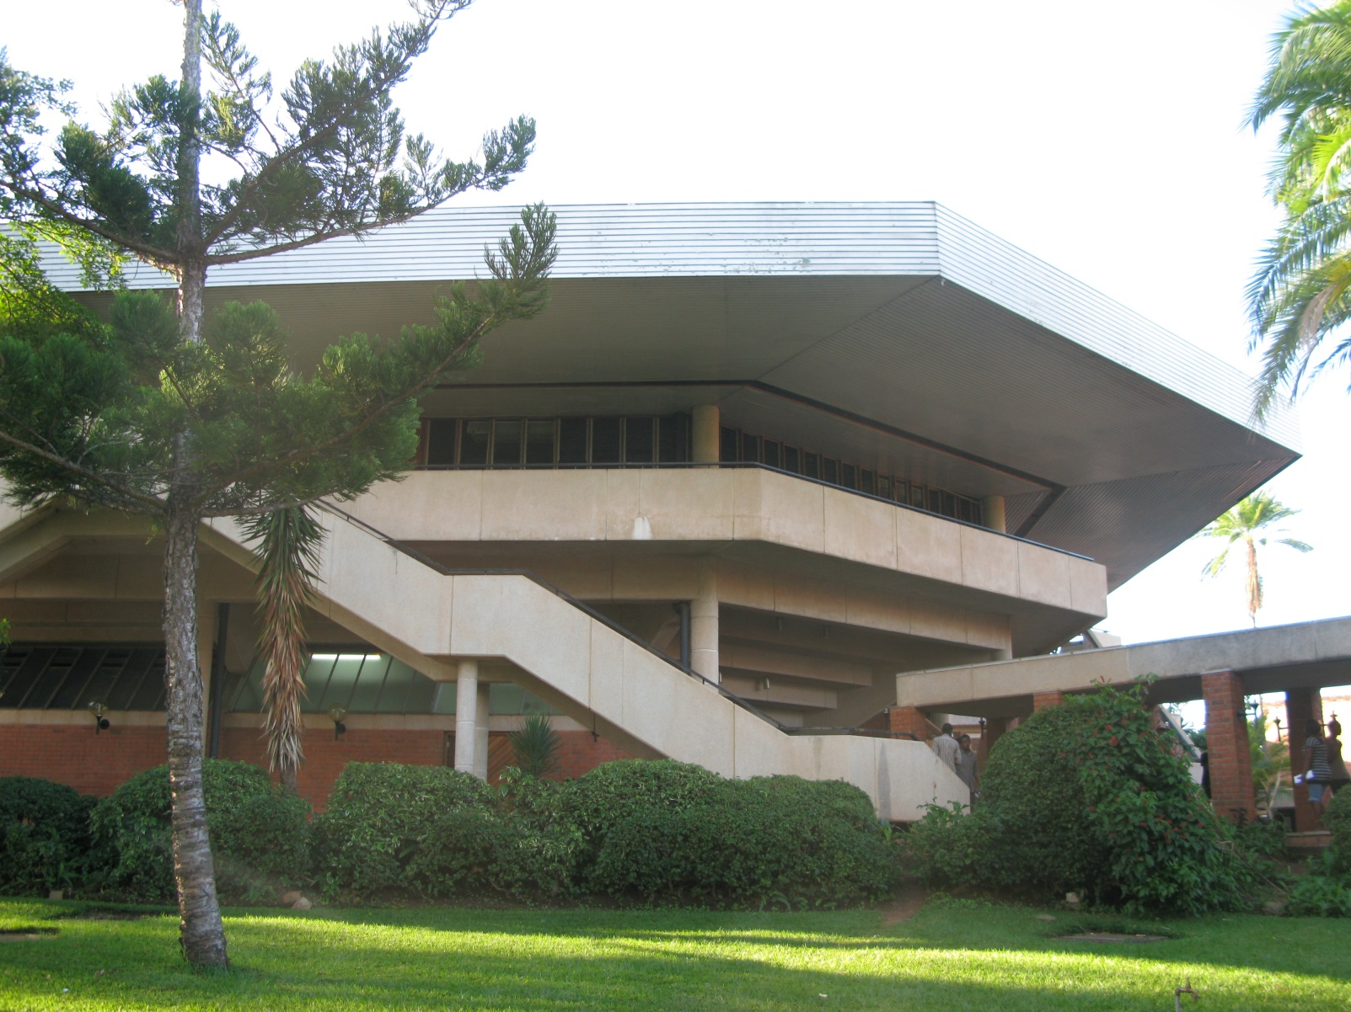
Look familiar?

Slide 12
Monday pm
Agreed some research projects with SW staff
  1. Seeking the views of young adults who have left several forms of 'residential' care
  2. Assessing the potential roles of social workers in Malawi
  3. Researching the views of students on the programmes

Slide 13
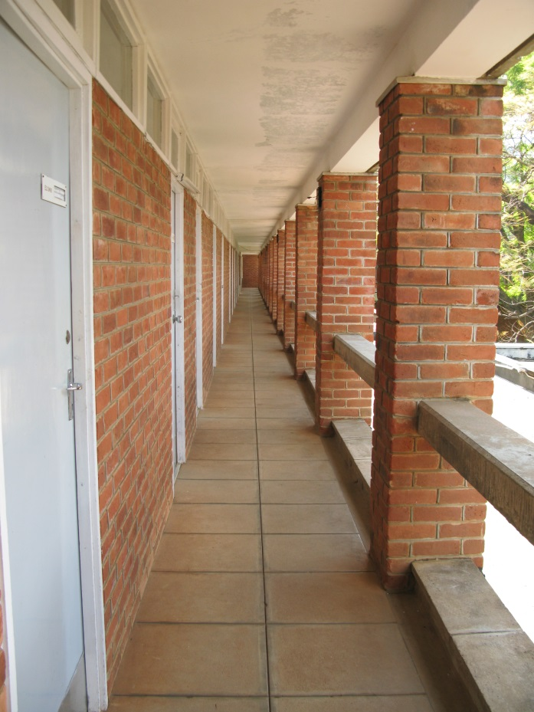
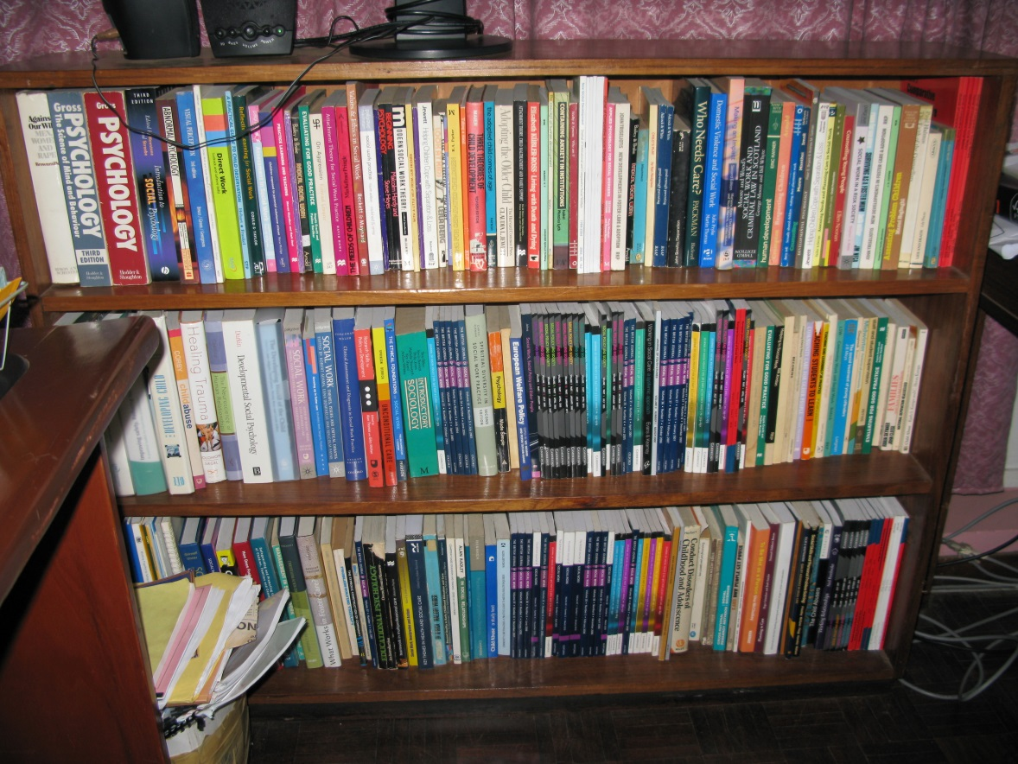
Wednesday am
Worked with the SW team (and some psychologists) on how to set up placements

Slide 14
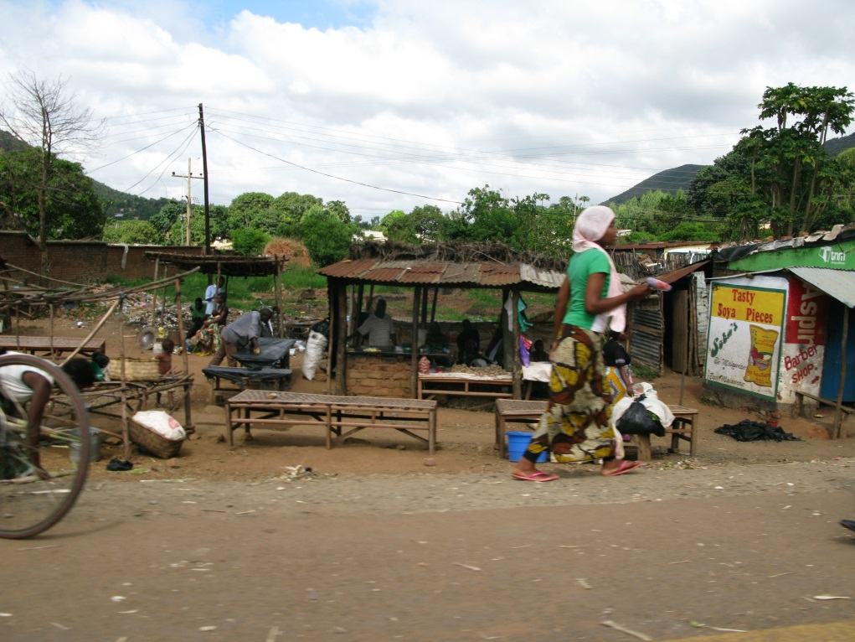
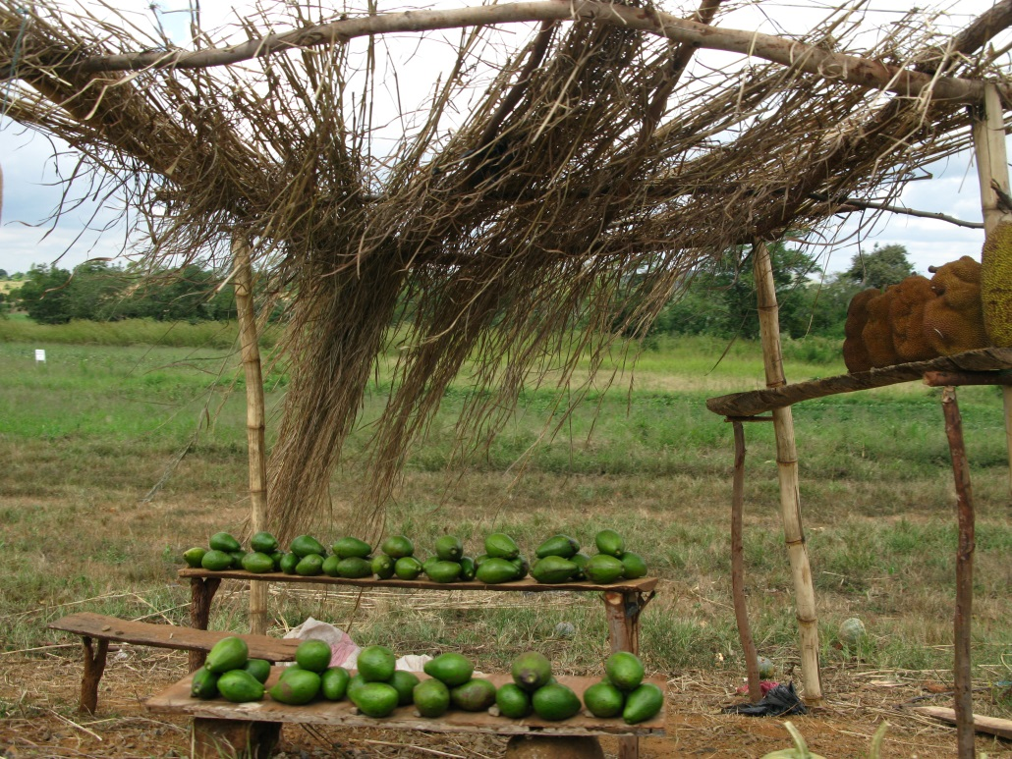
Wednesday pm
Visited Magomoro College, where UNICEF students are based.

Slide 15
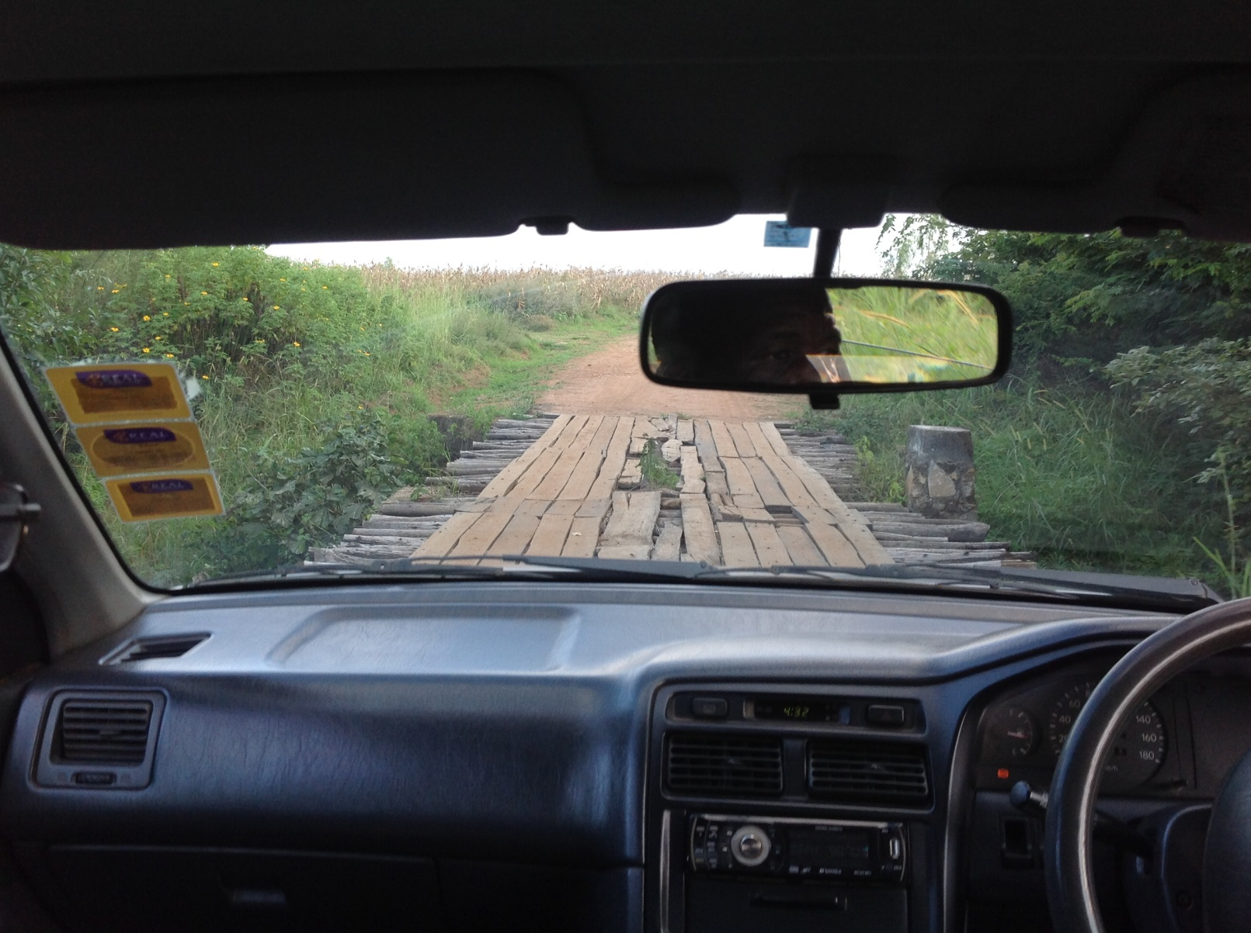
The road to Magormoro

Slide 16
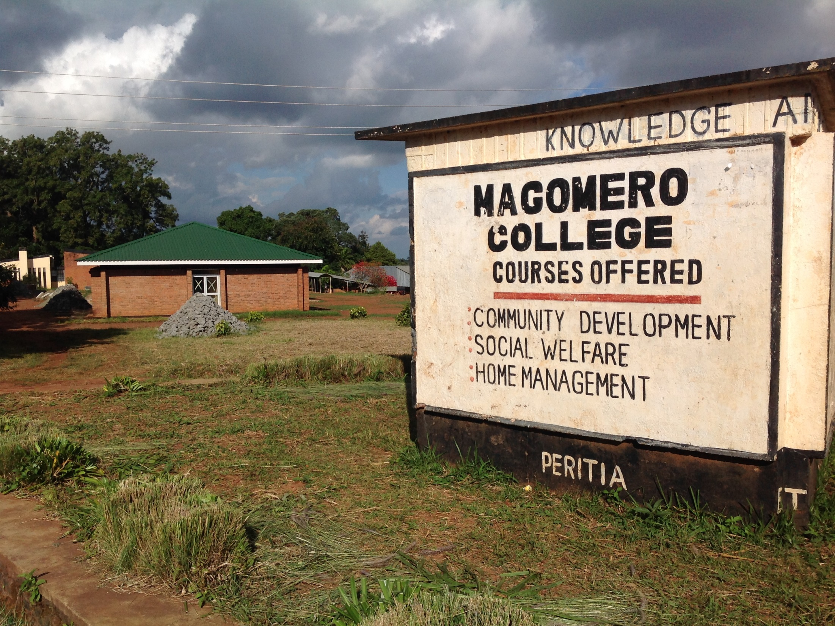

Slide 17
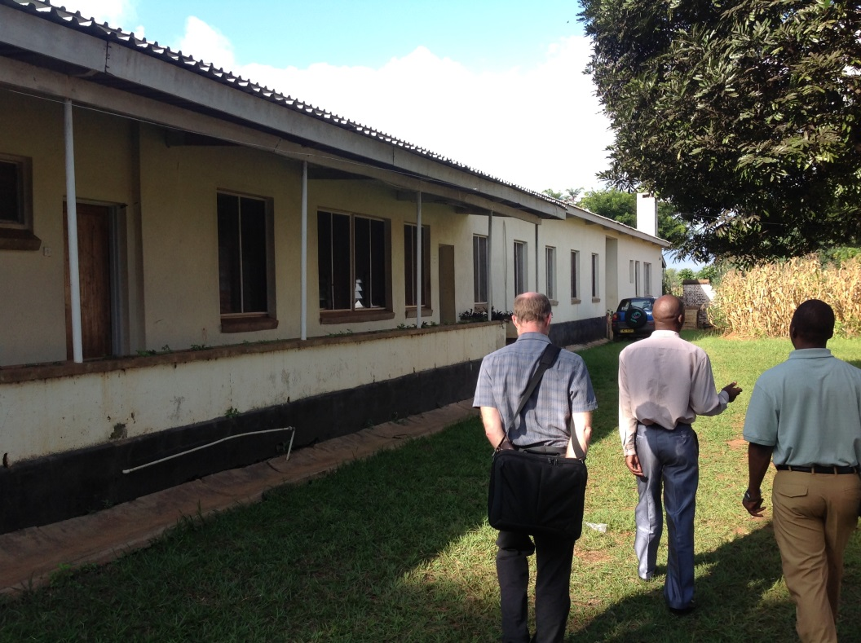
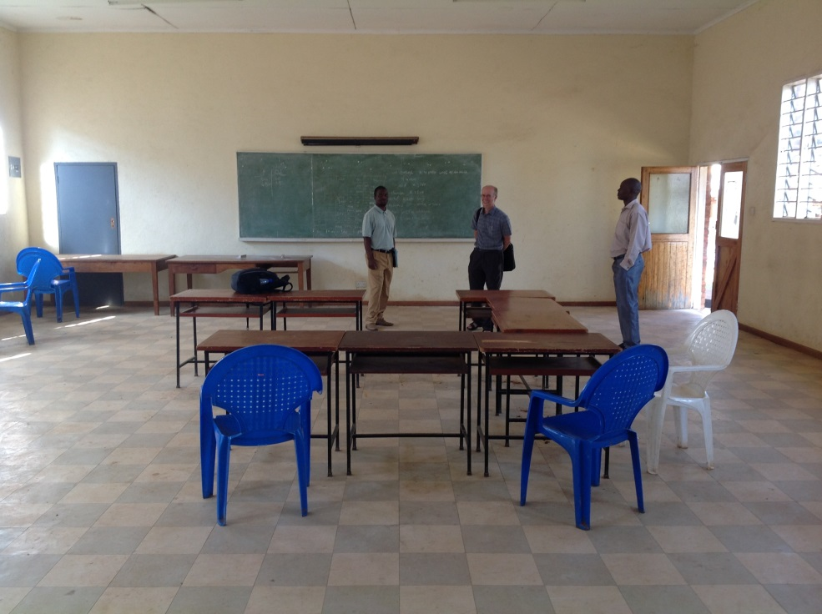
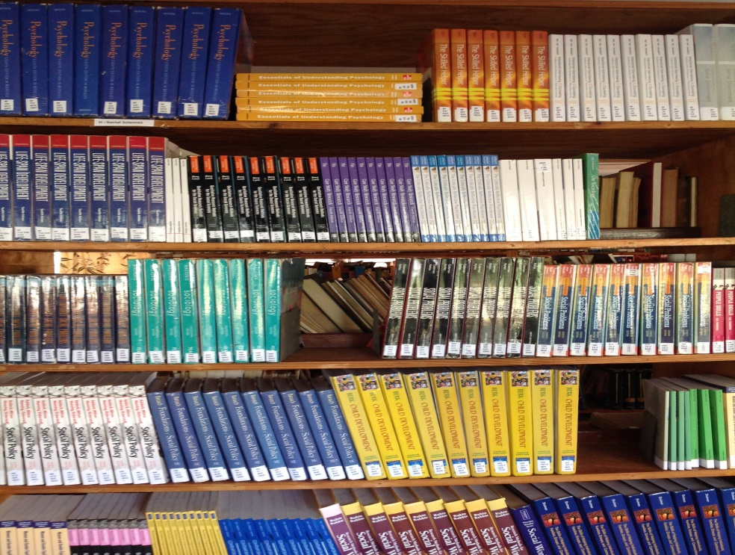
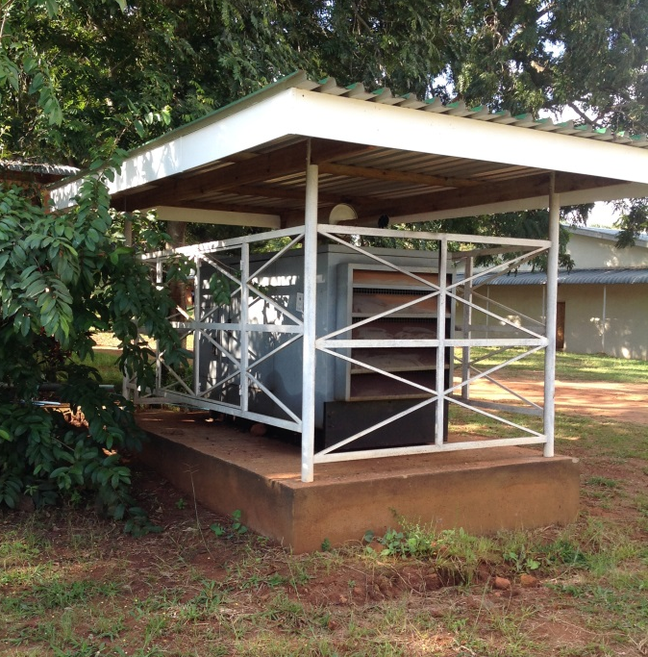

Slide 18
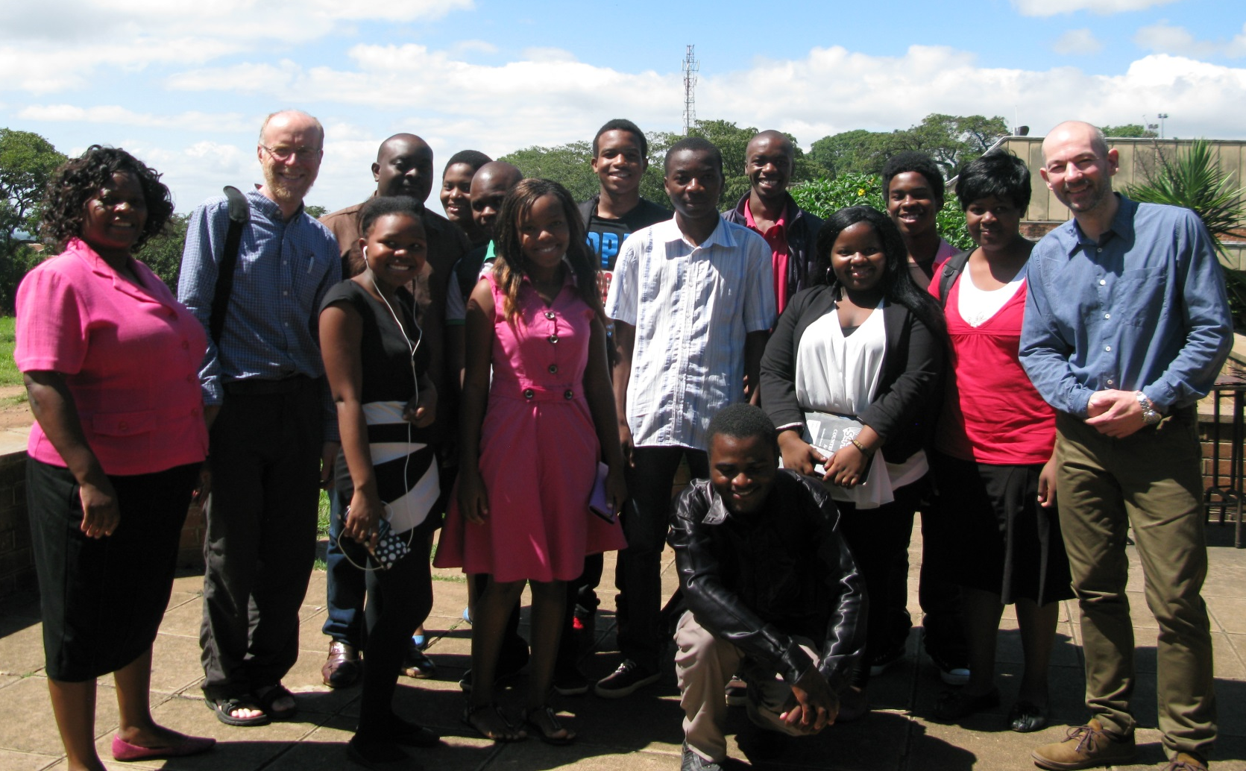
Thursday am
2 hour teaching and learning session with Chanco students on Assess/Plan/Review/Intervene cycle

Slide 19
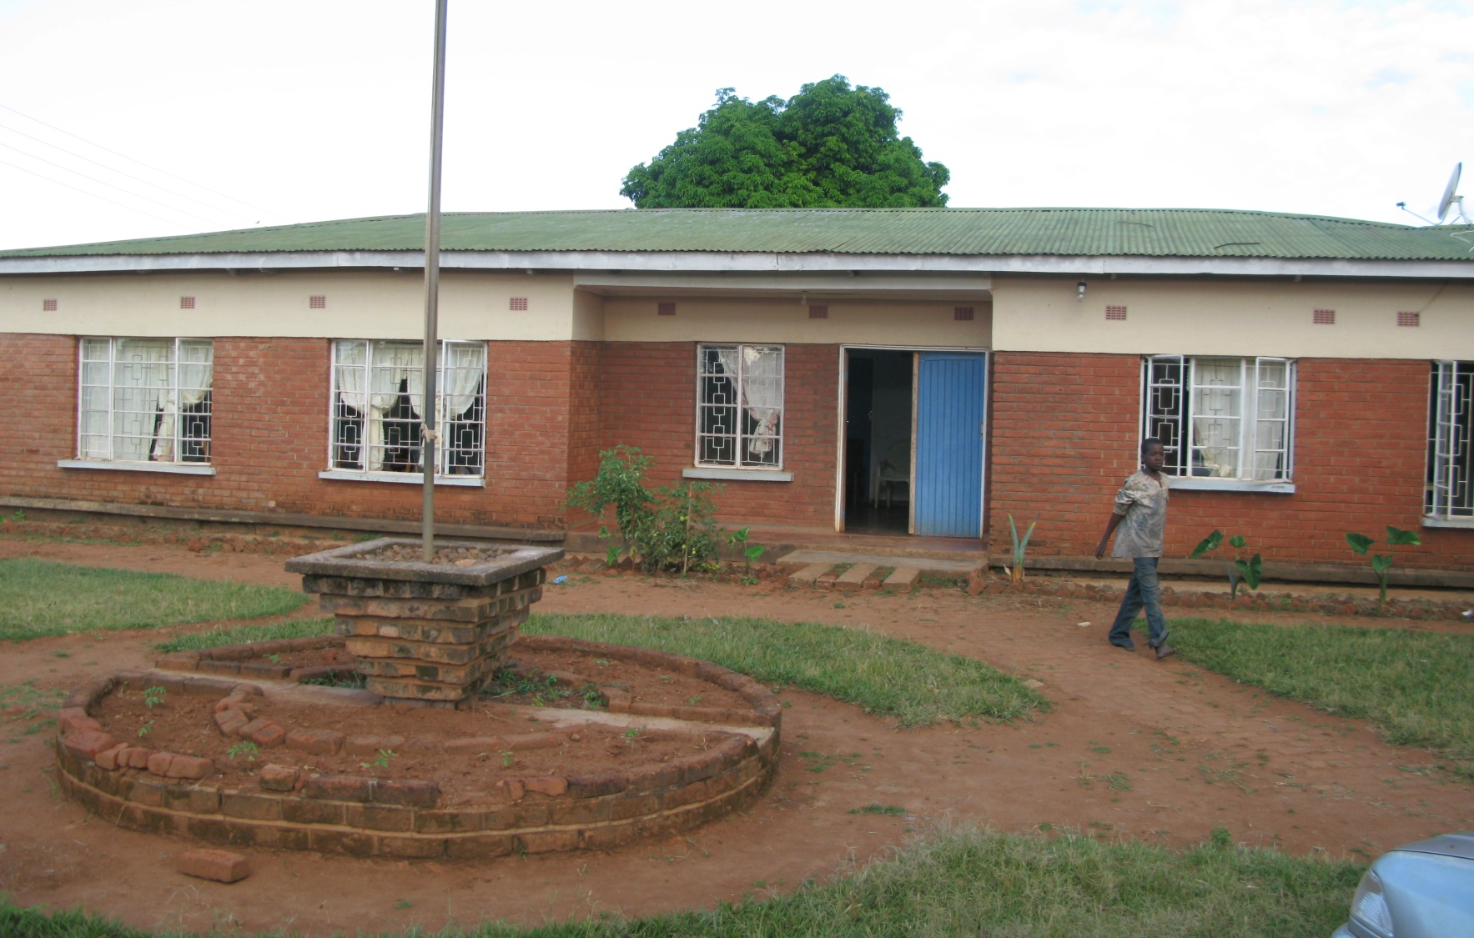
Thursday pm
Visited a ‘Reformation Centre’ for teenage boys – with a view to placing students there

Slide 20
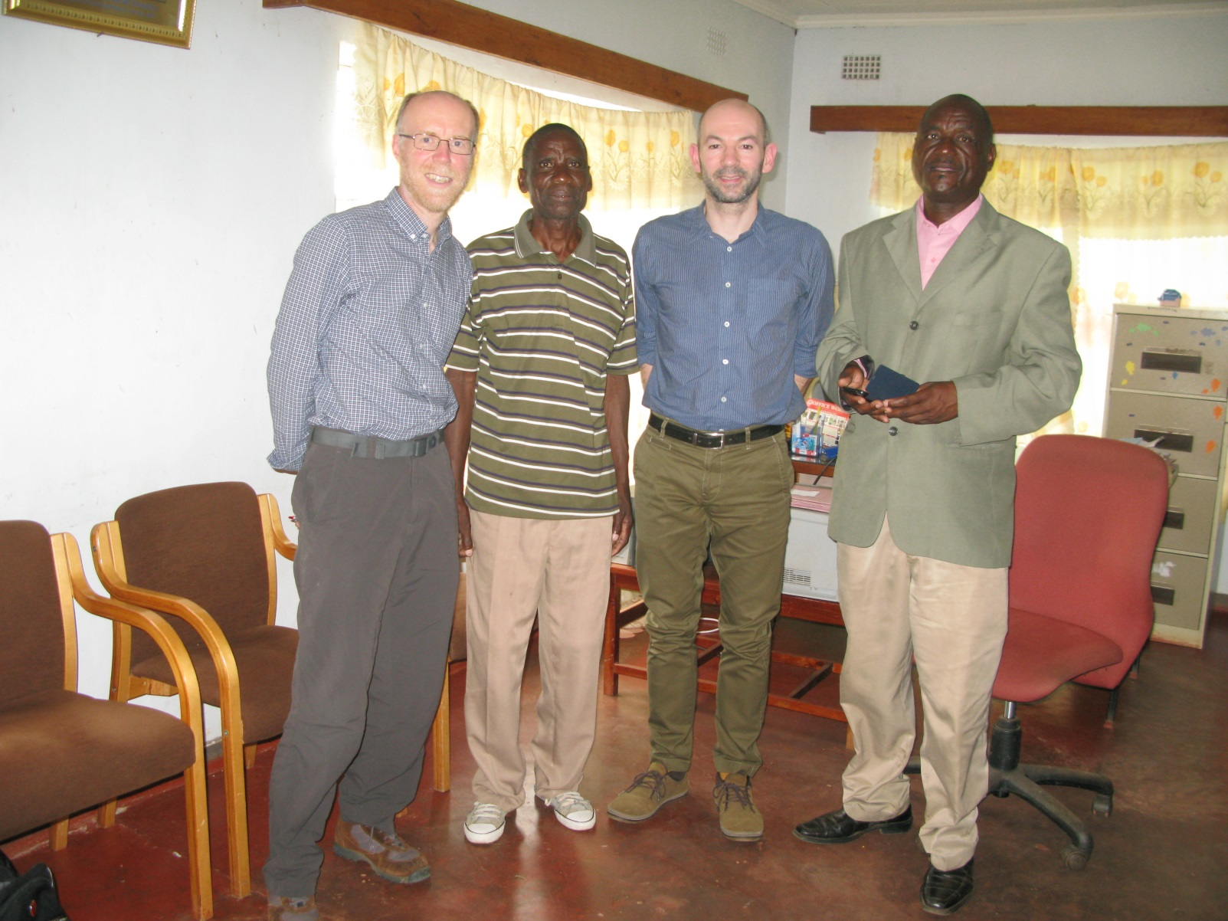
With the manager and care worker

Slide 21


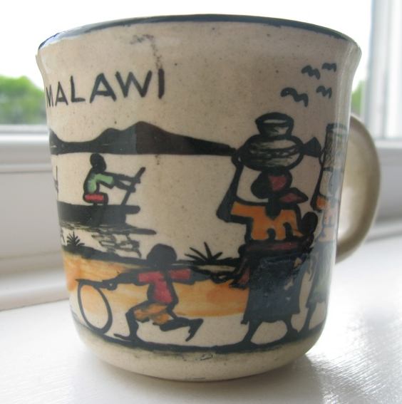


Friday
Did some forward planning with the senior staff on next steps in cooperation UK and Malawi
Tried to buy a mug! Less said, the better!

Slide 22
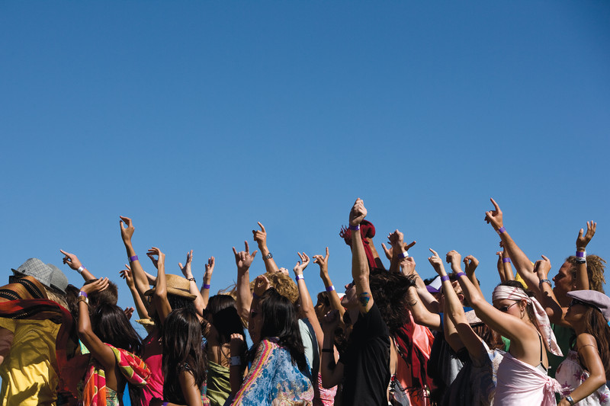
Any questions?
Any questions?
Any questions?
Any questions?
Any questions?

